Slide 1
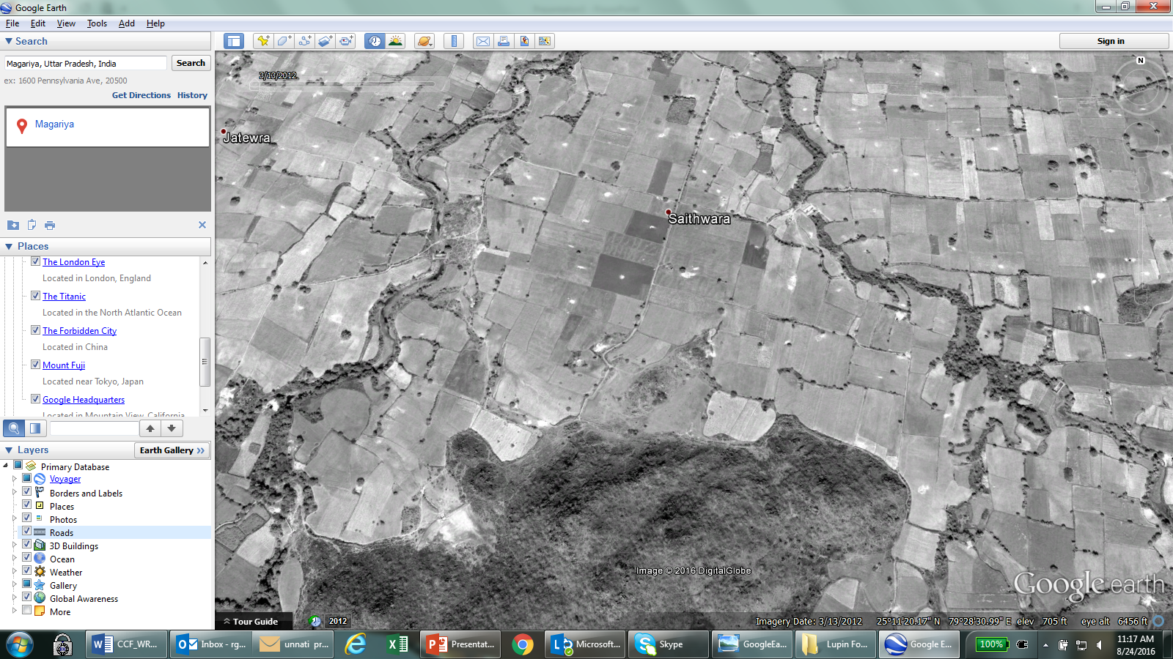
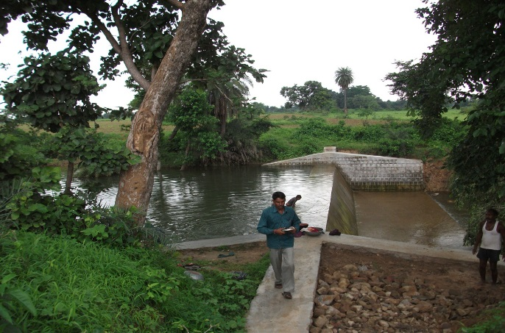
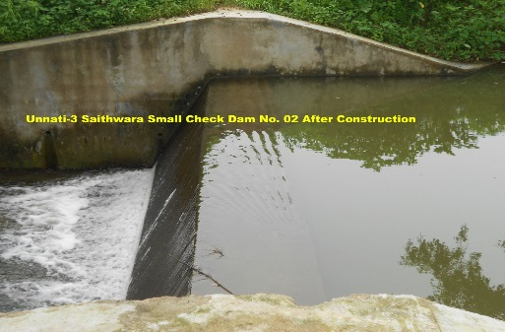
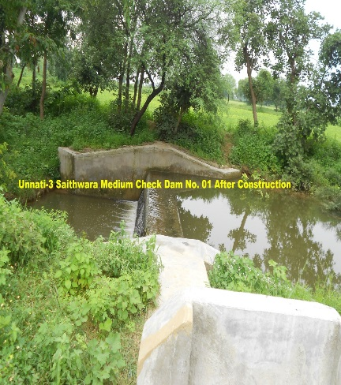
completed check dams, marked on google earth….March 2012
Saithwara CD-III
Saithwara CD-II
Saithwara CD - I

Slide 2
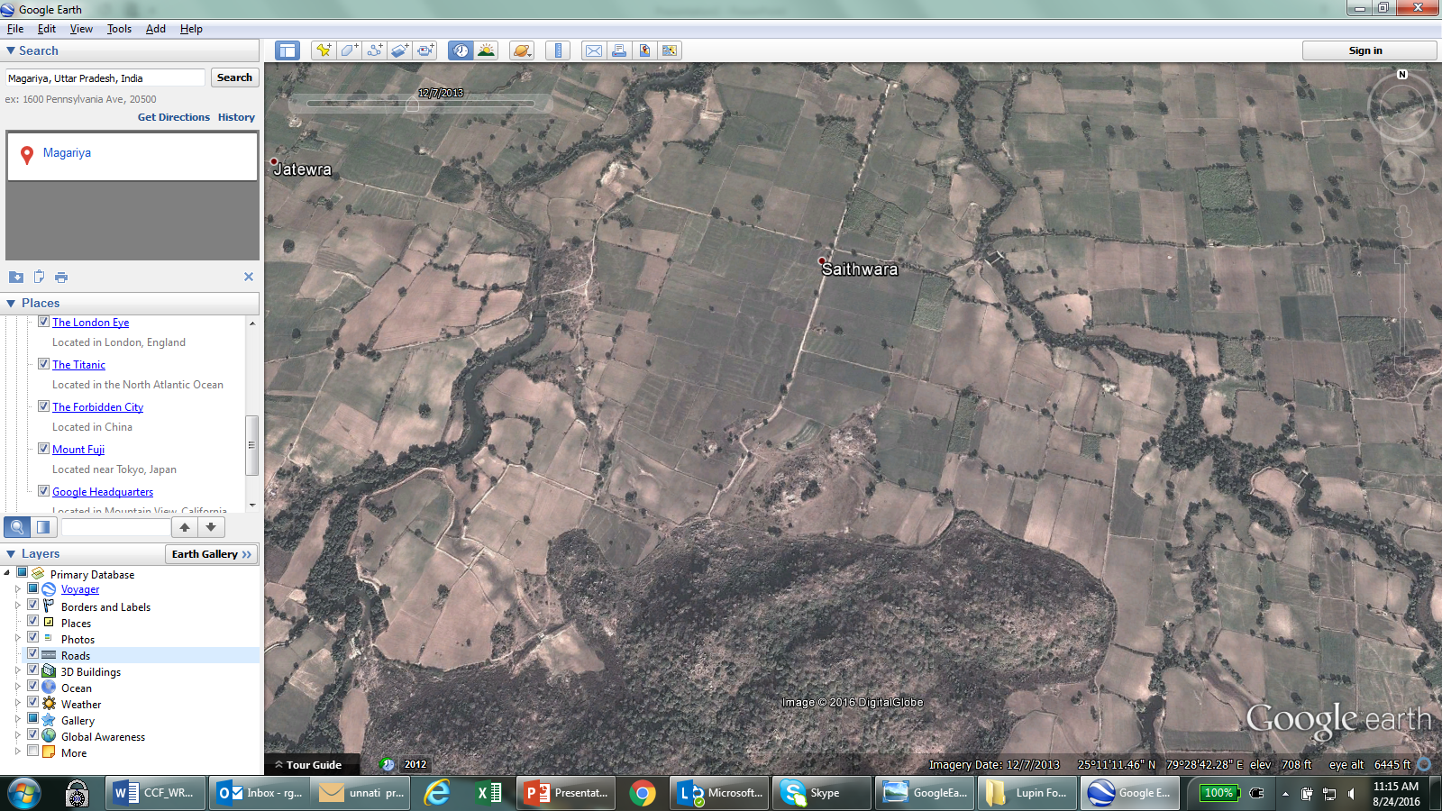
A late monsoon & deficit rains in 2013….December 2013

Slide 3
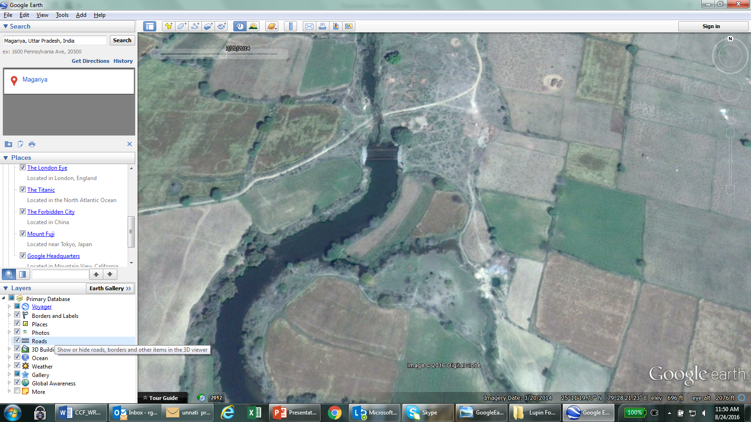
A closer look at our check dam with water….

Slide 4
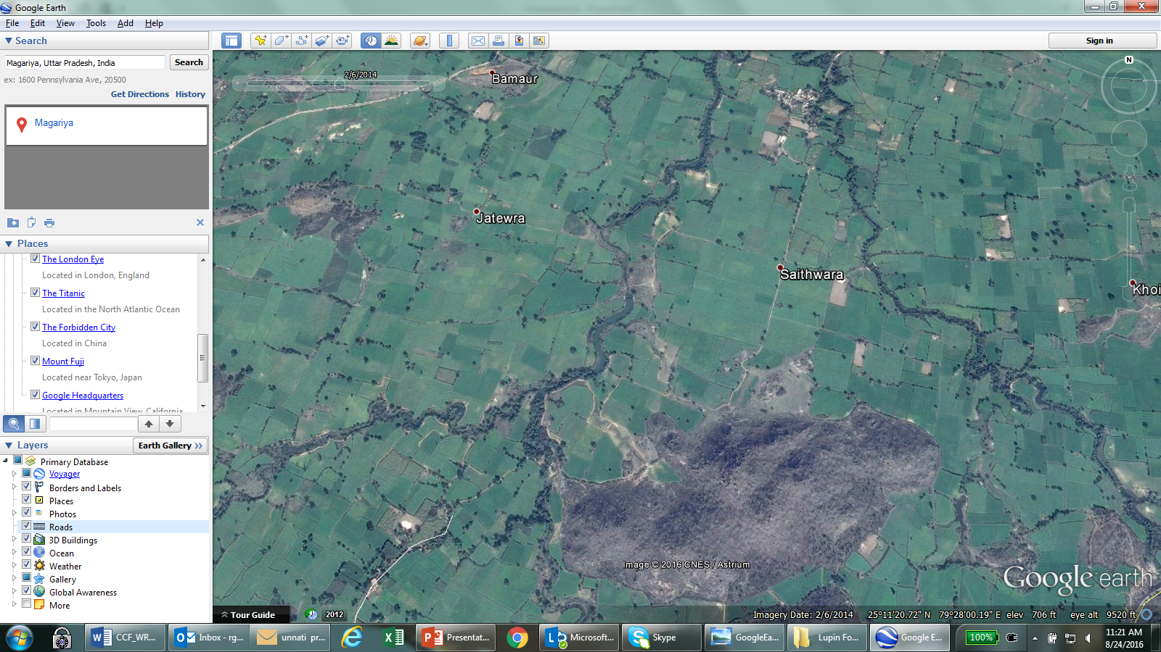
winter crop of wheat near our project sites … February 2014

Slide 5
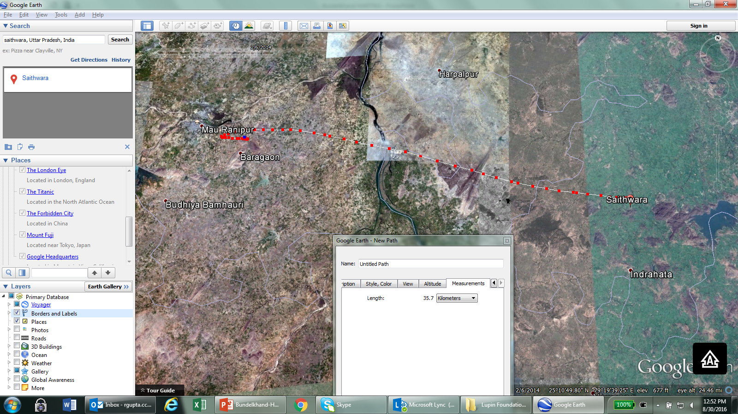
Bargaon 36 km from Saithwara (our project location)...February 2014

Slide 6
