Slide 1
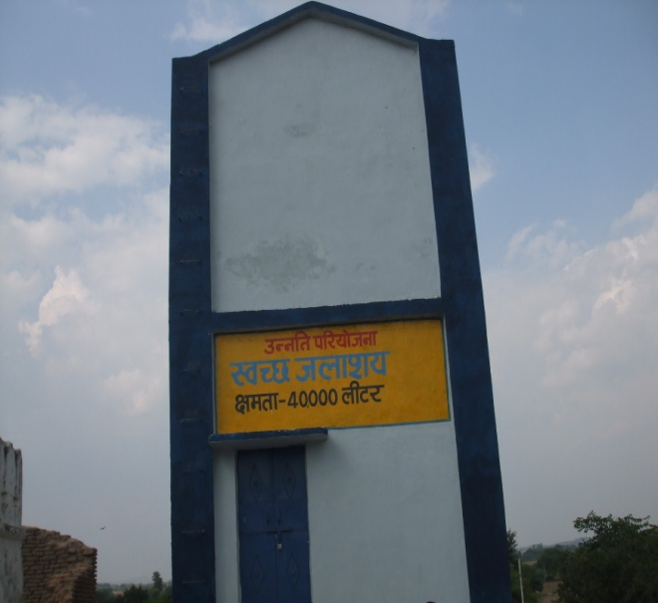
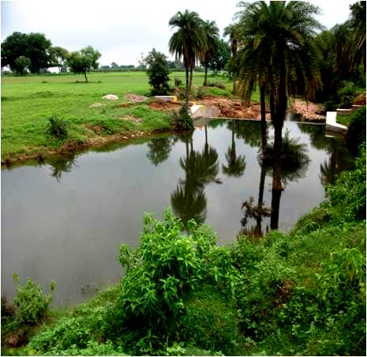
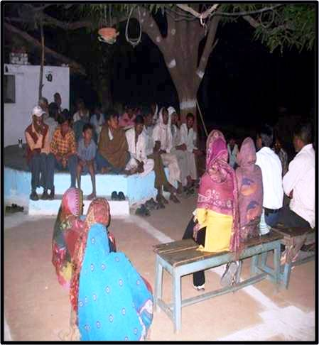
Community Action in Water Project Sustainability Sustainable Systems as Solutions
By-Avani Mohan Singh

Slide 2
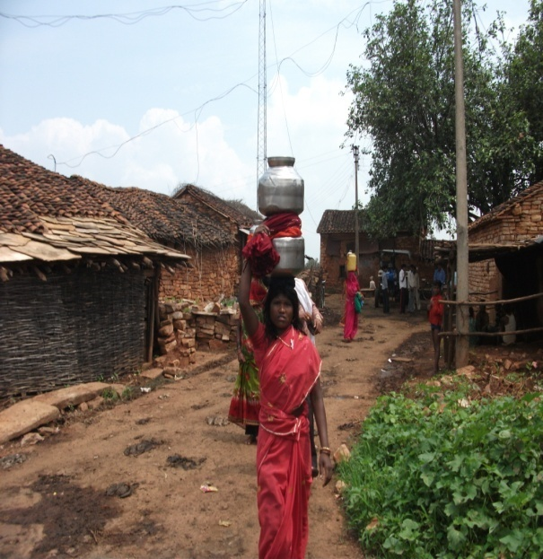
Water- A Problem at Global Level
According to Nature (2010), about 80% of the world's population (5.6 billion in 2011) live in areas with threats to water security
Populations continue to grow; so, despite progress, we are no better off than we were in 1980!
A 2006 United Nations report says "There is enough water for everyone” and "Water insufficiency is often due to mismanagement, corruption, lack of appropriate institutions, bureaucratic inertia and a shortage of investment in both human capacity and physical infrastructure"

Slide 3
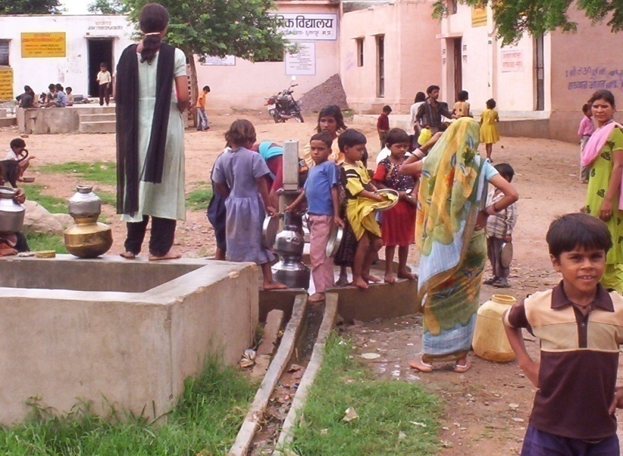
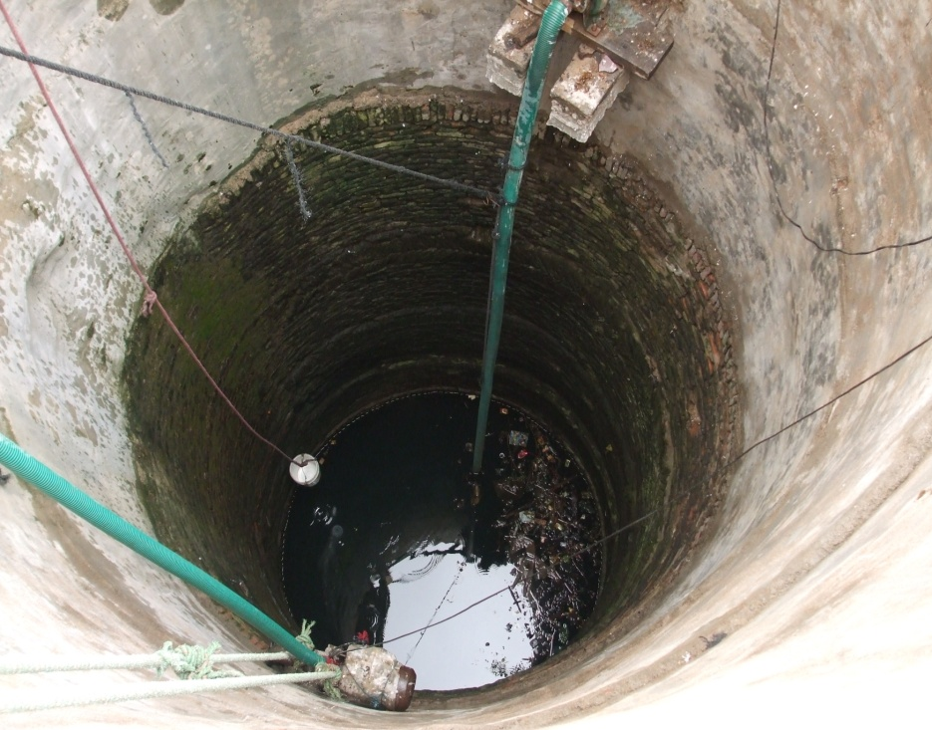
Issues in Bundelkhand Region
As per NFHS-3 (2005-06), only 8% rural population had access to pipe water supply schemes, whereas rest depended on hand-pumps or dug wells.
Along with inadequate availability, water quality is also affected by various contaminants.
Women and girls have to travel miles and spend 6-8 hours daily for collection of water, causing negative effect on health.
In absence of mother, girls have to collect water that negatively affects their education.

Slide 4
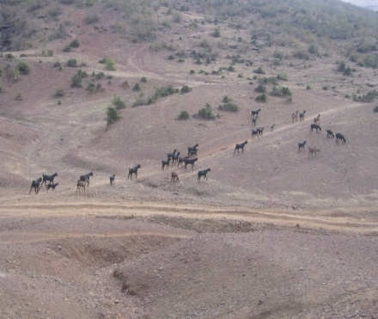
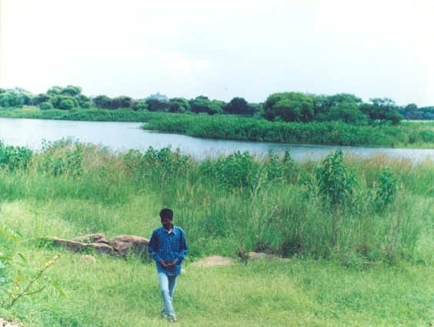
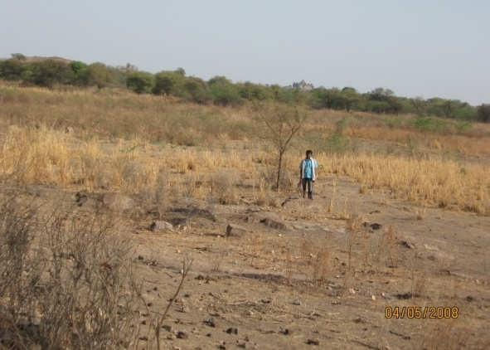
Issues in Bundelkhand Region
The whole region falls under drought prone zone, ground water has been taped for agriculture purpose through boring, resulting in depletion of ground water.
Most of the regions where water is available, the farmers produce cash crops (Water Intensive Crops).
For irrigation purpose, the farmers take loan from local money lenders and return them with high rate of interest that possess economical risk in their life.
Degraded Grazing
Condition of pond in 2003
Condition of same pond in 2008

Slide 5
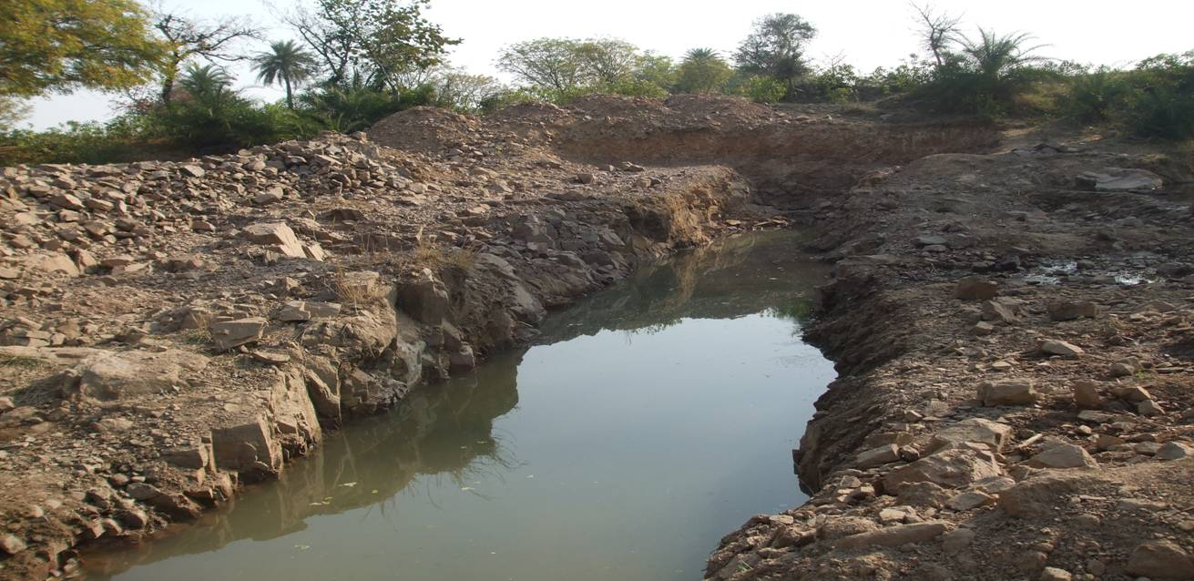
Scope of Intervention in Bundelkhand Area
Through construction of water harvesting structures scope to increase ground water table.
Construction of continues contour trenches around the hill slope at the given contour for treating non arable area of hill slopes.
Scope for the improved and diversified agriculture which will create additional employment in the farm sectors.
On Blasting Recharge Zones

Slide 6
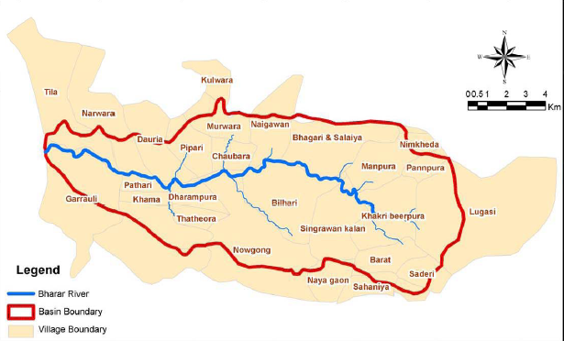
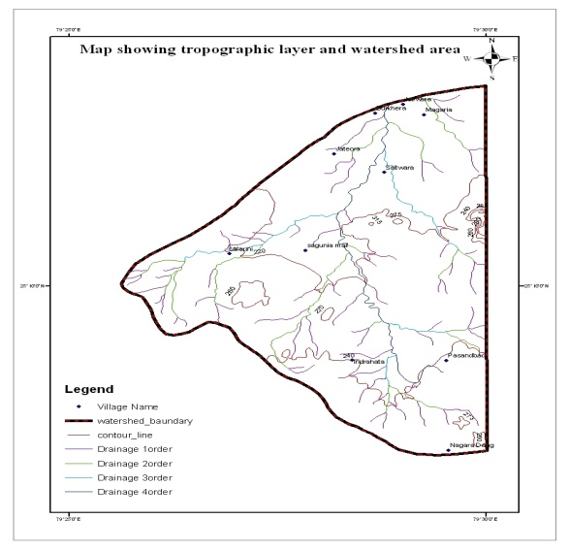
Projected Bhadar River Basin in Chhattarpur
Projected Karpia River Basin in Mahoba

Slide 7
Against the above back drop
Projects titled
“Towards Drinking Water Security through IWRM Approach in Bharad River Sub-basin, Nowgaon Block, Chhatarpur (M.P),INDIA” supported by Water-Aid
“Towards Drinking Water Security through IWRM Approach in Karpia River Sub-basin, Jaitpur Block, Mahoba (U.P),INDIA” supported by Anandana Foundation.
A Water shed Project- Sunehra Kal supported by Anandana Foundation
Have been implemented in identified villages
“These projects aim to reduce the risk of groundwater depletion, ensure reliable drinking water supplies throughout the year and encourage equitable sharing of water for domestic and irrigation needs.”

Slide 8
PROJECT COMPONENT
Water Conservation on Community based WRM approach
Community mobilization and Institutional capacity building
Rejuvenation of existing infrastrucre and creation of new facilities

Slide 9
Steps of Project Implementation
Creating awareness and ensuring community participation (From planning to O & M stage.)
Formation and strengthening village water supply and sanitation committee for program execution.
Conducting participatory water need assessment.
Identification of sources through geophysical and hydrological investigation and ascertaining the ground water potential through pump test.
For quality of drinking water conducting bacteriological and hydro chemical test.
Finalizing the source of safe drinking water.
Procurement of services and materials through VWSC to ensure transparency
Implementation of hardware activities to create water supply facility with basic provision of household connection.
Adopting integrated approach of drinking water and sanitation to minimize sanitation related risks.
Supporting all the drinking water sources with source strengthening measures to ensure long term sustainability.
Withdrawal of Water Supply system to Village Water & Sanitation Committee.

Slide 10
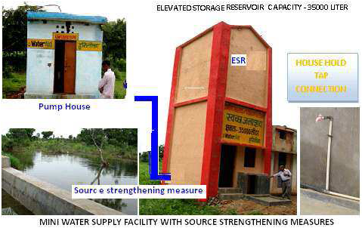
Interventions to improve drinking water access
Nowgong & Jaitpur Block
Based on ground water sources and consisting of source well, pump house, ESR (Elevated storage reservoir) and household connection are promoted in the villages.
16 Mini water supply schemes have been constructed in villages situated in Bhadar River Sub-basin of Nowgong block, Chhatarpur.
12 Mini water supply schemes have been constructed in villages situated in Karpia River Sub-basin of Jaitpur block, Mahoba.

Slide 11
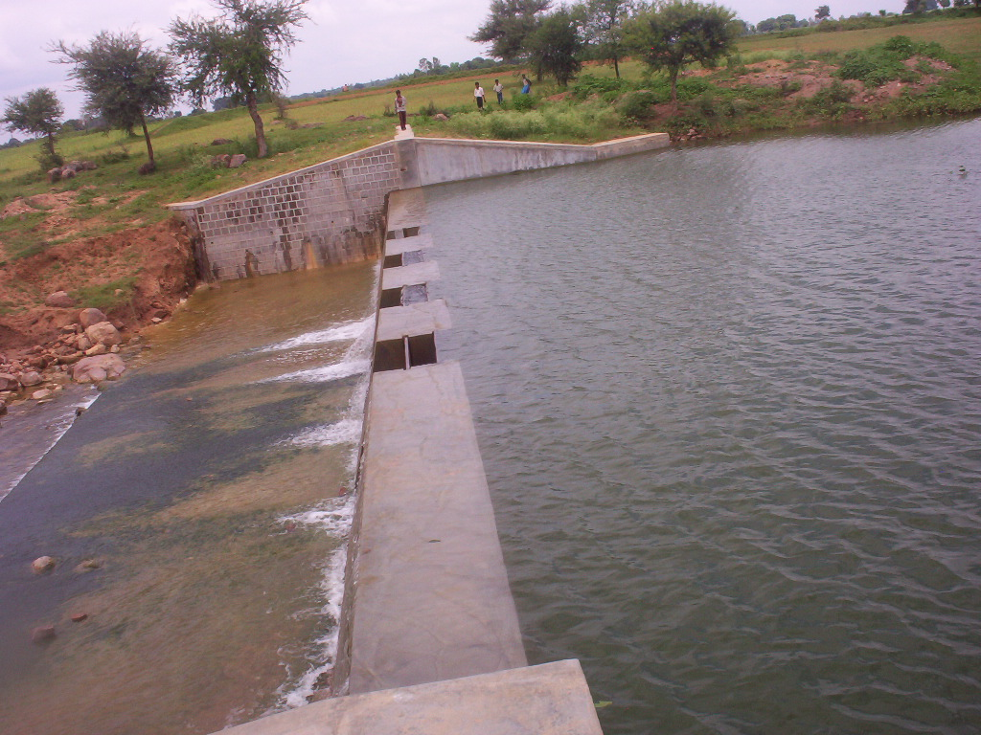
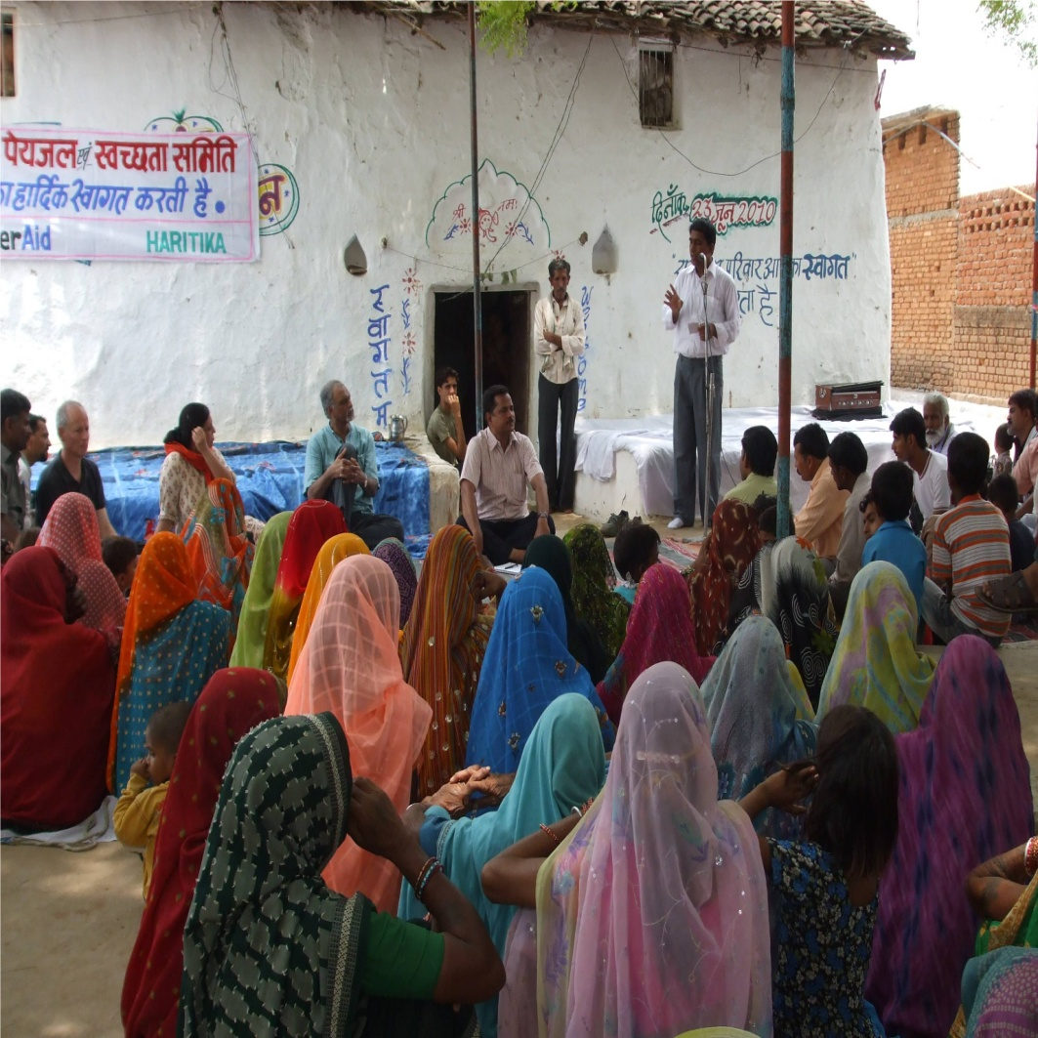
Salient features of the created water supply facilities
Source Sustainability
System Sustainability
Under this programme household connections are provided therefore due precaution are taken to ensure long term sustainability of drinking water sources.
All drinking water schemes are supported by sources strengthening measures.
Major focus is given on drainage line treatment to improve ground water availability in the area
Local institutions (VWSCS) are formed and strengthened. Bank accounts are opened.
Community contribution is a mandatory part of these schemes and it is ensured that a sum of Rs. 1000 per family is deposited in the VWSC account preferably before the commencement of work.
Cost of operation and maintenance is also worked out and shared with community members and they have committed to pay the same.
All these measures will ensure sustainability of system and is important to run the scheme smoothly on a long term basis.
Costing of these schemes
On an average the per capita costs of these schemes are in the range of Rs. 850-1150 for the current population where as standard per capita norms for drinking water supply schemes are Rs.2200.

Slide 12
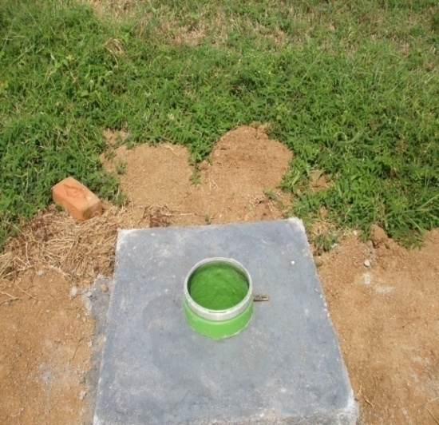
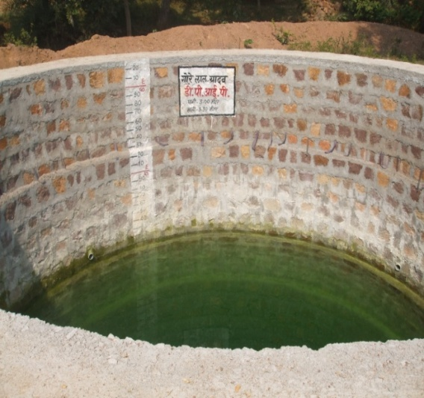
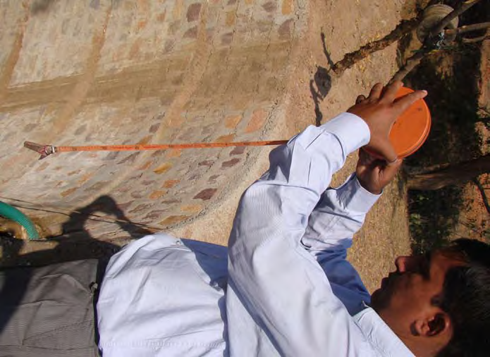
IWRM INITIATIVES in Bhadar River Sub-basin
On the main Bhadar River, 5 check dams are constructed to reduce the flow velocity.
Drainage line treatment were carried out on two local streams which covers at least 7 check-dams in series. Local stream with an approximate length of 2.5 km originates from an ancient pond and joins river Bharad in Nowgaon block.
• As part of drainage line treatment 7 check dams are constructed in a series on one stream from its starting point till end point and on another stream coming from north direction of Bhadar river, two Stop dam are constructed.
From year 2003-2011, total 45 check-dams have been constructed on Bhadar River Basin.
30 observation wells, 6 RWH structures, 3 rain gauge stations has been established in villages of Bhadar River Basin.

Slide 13
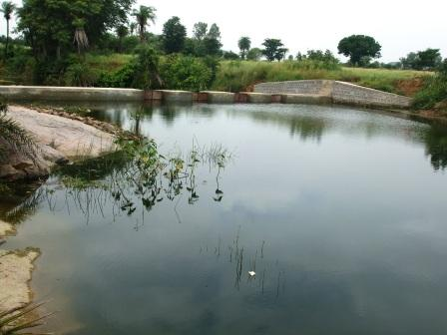
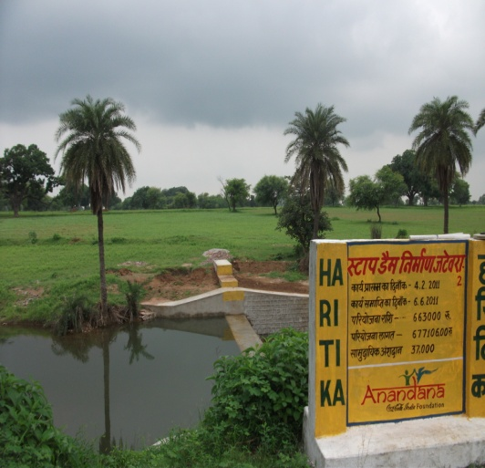
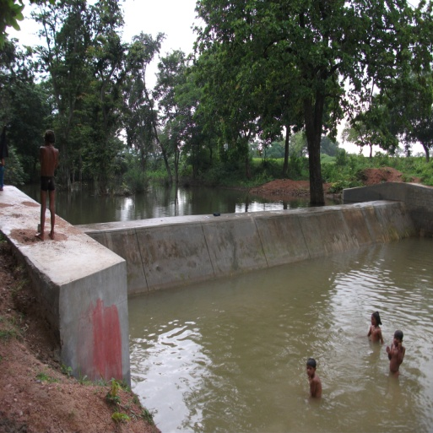
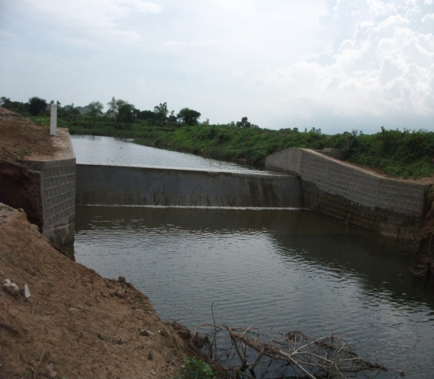
Water-shed INITIATIVES in Karpia River Sub-basin
Under Unnati-1 Project total 5 check-dams have been constructed in 4 villages
Under Unnati-2 Project total 9 check-dams have been constructed.
Under Unnati-3 Watershed Project-Sunehra Kal, till now 10 check-dams have been constructed.

Slide 14
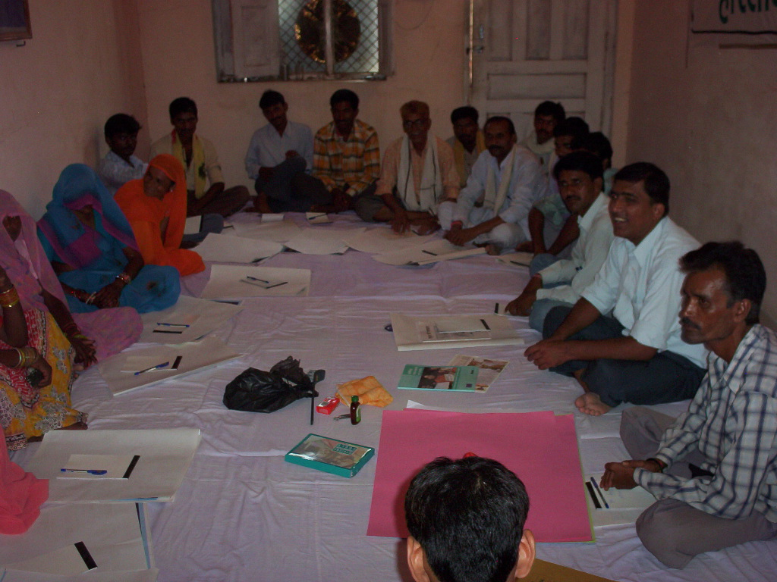
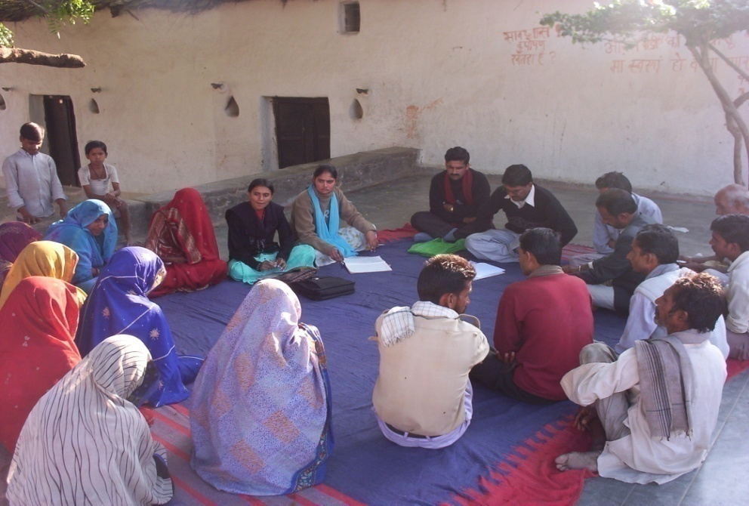
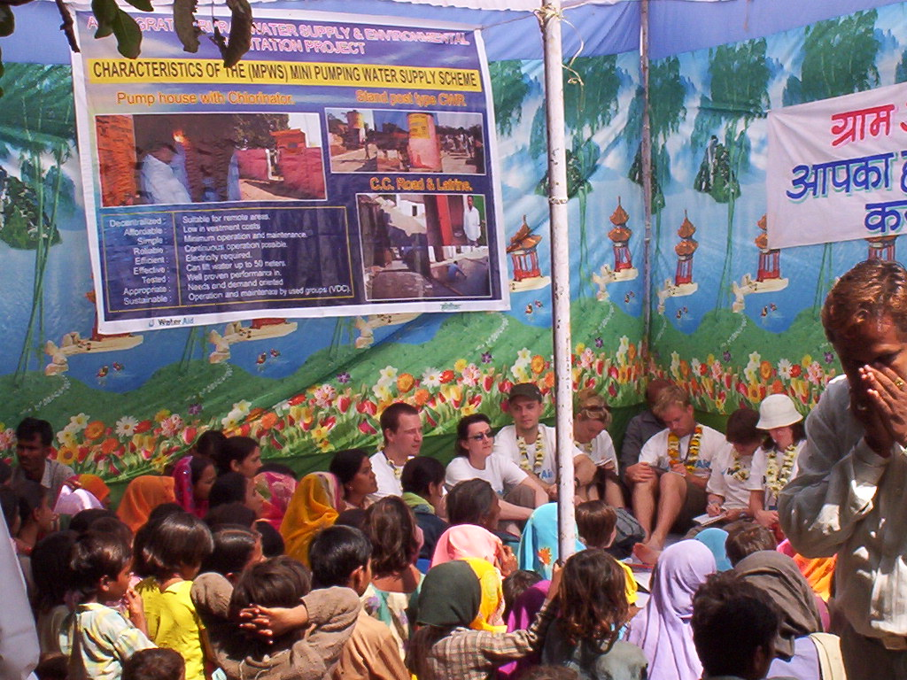
Community Is Key
community projects cannot remain in isolation and pockets or islands of good practice need to be scaled-up and linked.
Haritika helps communities engage effectively with those at district, regional and national levels and advocate for their government to recognize and enforce community schemes.
Community-based initiatives requires sustained financial input and capacity building.

Slide 15
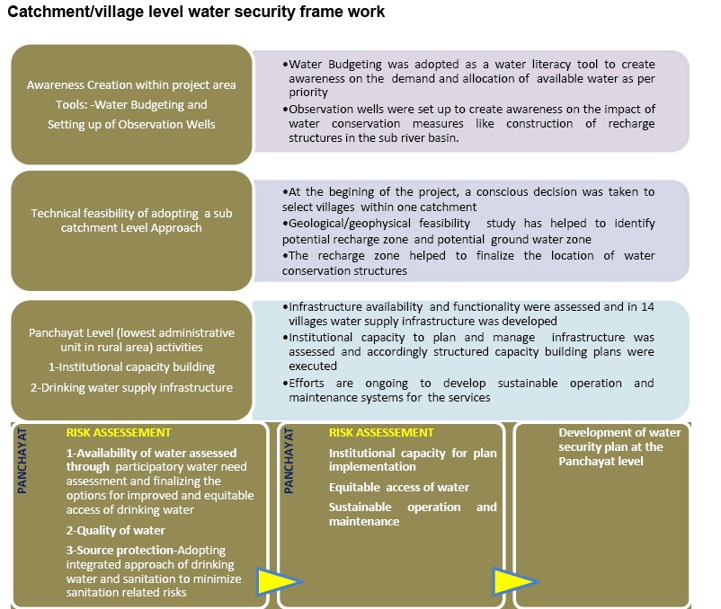

Slide 16
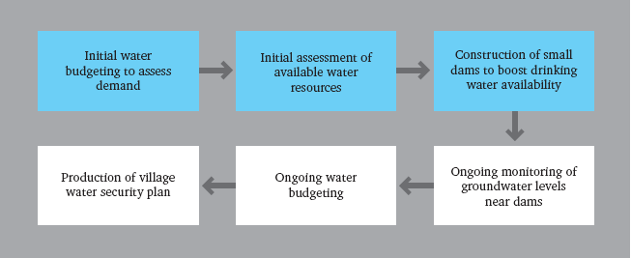
The Approach used to Initiate Water Security Planning in Bundelkhand
Attempts are being made to introduce the ongoing monitoring of agricultural wells so that the community can understand the demand and supply side of water management.
Monitoring wells have been set up to provide information about groundwater availability for drinking water supplies near the small dams.
The information collected from ongoing monitoring can be used to assess the risk that groundwater supplies will be depleted, enabling villagers to produce a water security plan outlining water use priorities and allocations.

Slide 17
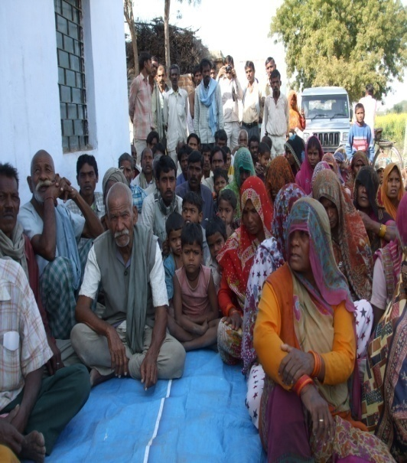
Community Mobilization Efforts & Outcomes
In each of these villages, a village water & sanitation committee have been constituted.
Strengthening of village level institutions through a series of awareness creation and theme based training programme with the basic objective of ensuring asset sustainability.
In order to ensure participation and ownership among the community members, community contribution has been made mandatory and people contributed Rs. 1000 per family which is deposited in the VWSC account as a corpus
The communities are managing their systems themselves.
The VWSC members of 1st phase project villages have their own meeting registers & ledgers.
They themselves explains the process adopted for construction of the whole system.
For the sustainability of water supply scheme the villagers pay monthly charges that includes operator charges, electricity bills & sustainability charges.

Slide 18
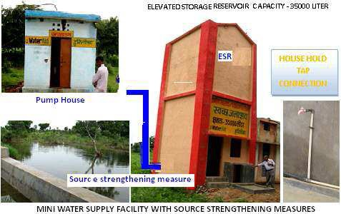
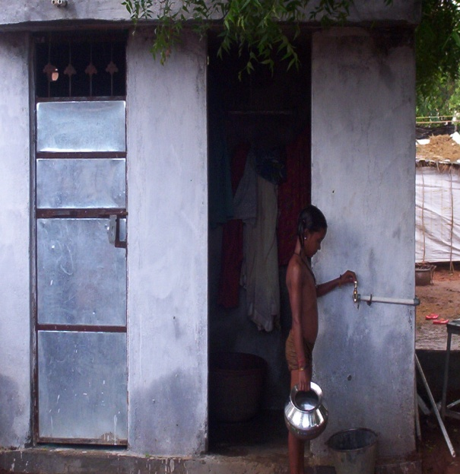
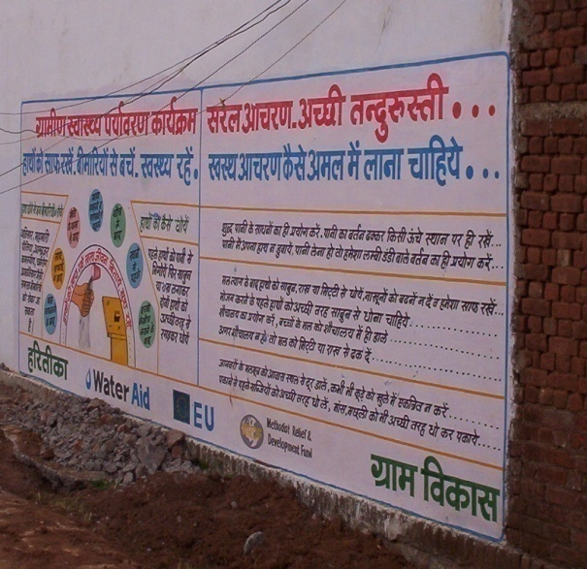
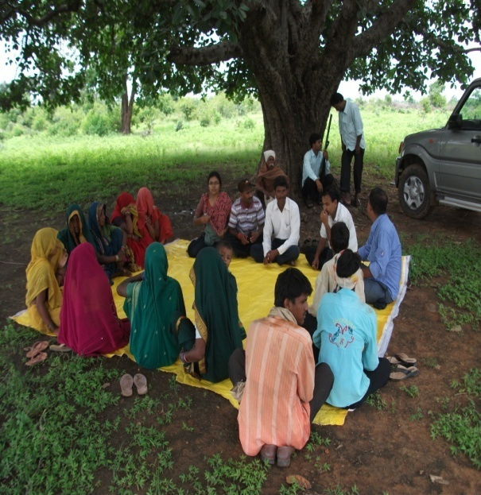
An Integrated Model Approach

Slide 19
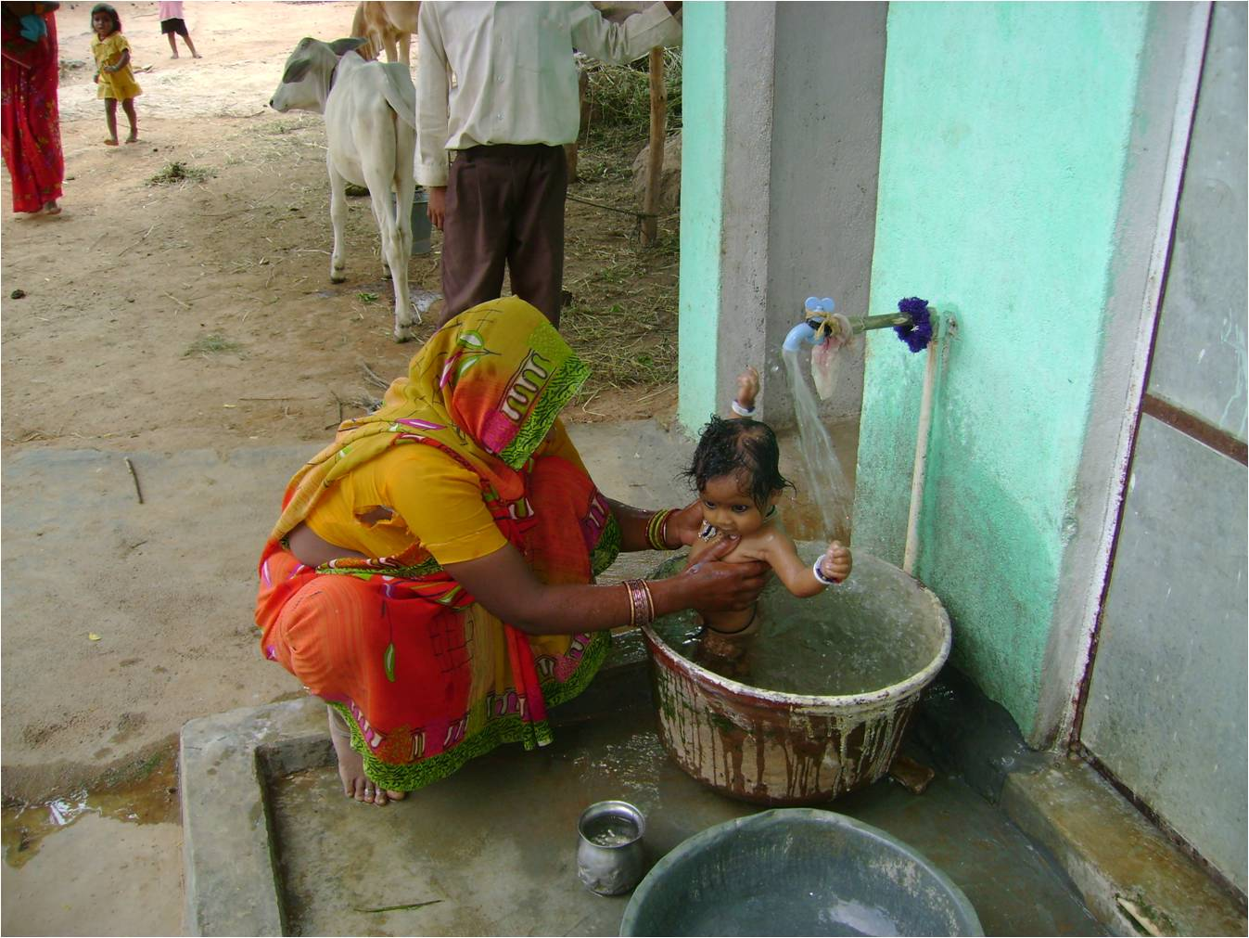
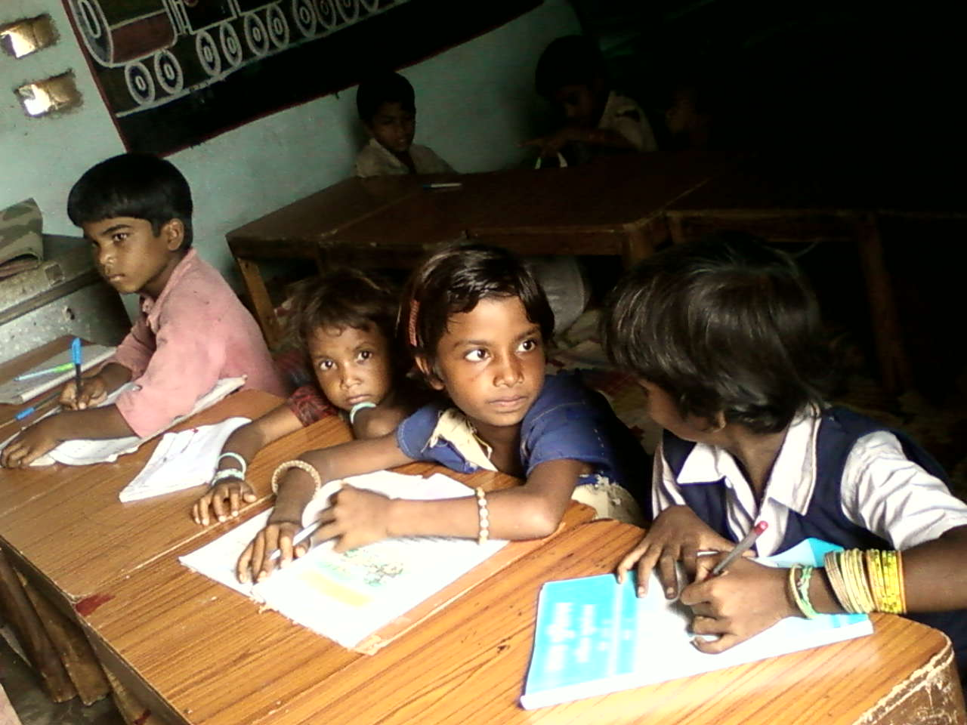
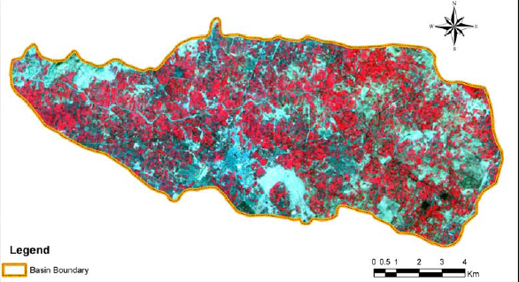
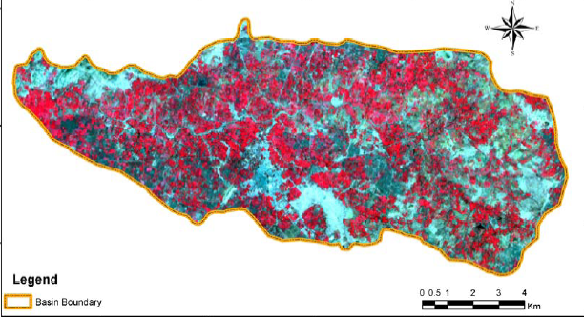
Outcome and learning's
With this intervention In 47 GPs a projected population of approximately 42,000 people are getting assured water supply to meet drinking and domestic water requirement.
Reduction in genito-urinary infections, reduced incidence of back pain caused by carrying water over long distances in women.
Increased educational attendance of girl children, in project villages.
Through concerted software support to the local institution and hand holding support, created infrastructure of rural water supply can be sustained over a long period of time.
Due to the construction of check-dams in Bhadar River Basin approximately 10,500 hectare land of Nowgong Block and in Karpia River Basin approximately 2357 hectare land is now irrigated.

Slide 20
Land-use & Land Cover Status after Intervention

Slide 21
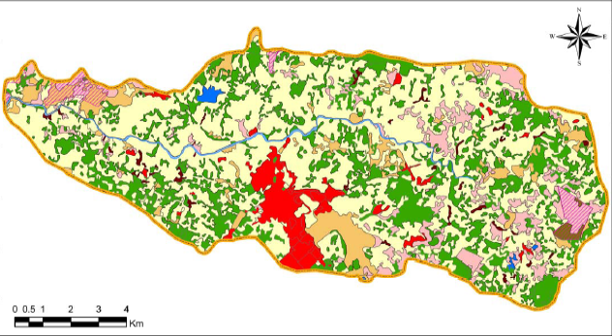
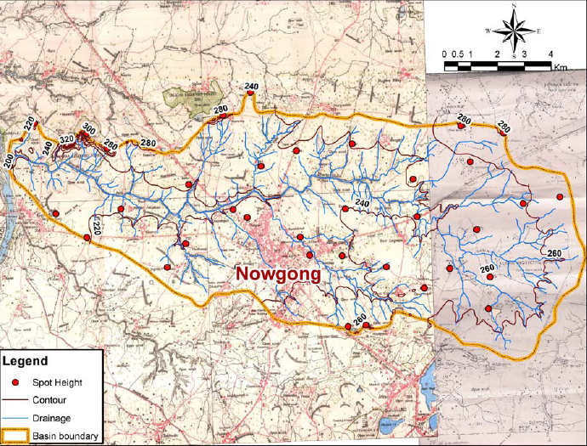
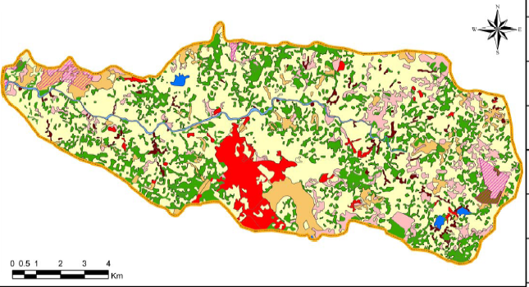
Impact of IWRM in Bhadar River Basin

Slide 22
Suggestions
A project can succeed if well defined framework of water sustainability and drinking water provisioning is adopted. These could be
Community level assessment of water requirement and its availability – Water Budgeting tools can be adopted
Adoption of catchment approach- To maximize the impact of water conservation measure it is essential to plan any project intervention by identifying a catchment
Geological feasibility study with in a catchment to identify zone of recharge and discharge- Conservation measure can be taken up in the zone of recharge
Apart from drainage line treatment, effort should also be made to tap roof water and storm water for recharge purpose
To measure the impact it is essential to establish a network of observation wells- this will also help to sensitize communities towards water conservation and management
Sensitizing communities towards improved irrigation practices and built their capacities for the use of tools like water budgeting
Fro drinking water provisioning involve communities right from planning stage and establish a system from sustainable Operation and maintenance

Slide 23
Singrawan Kalan

Slide 24
Singrawan Kalan

Slide 25
Check-dam of Pathari
Check-Dam of Pathari

Slide 27
THANKS

