Slide 1
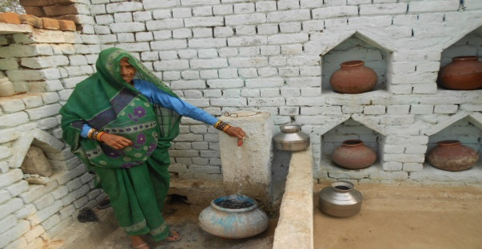
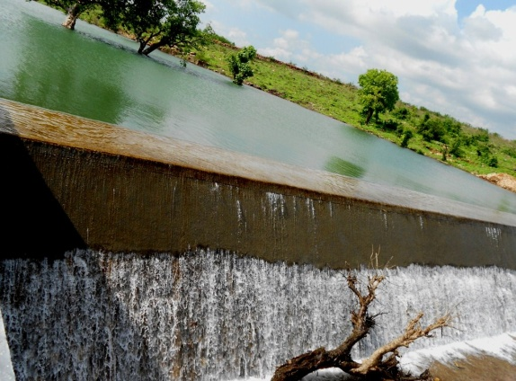
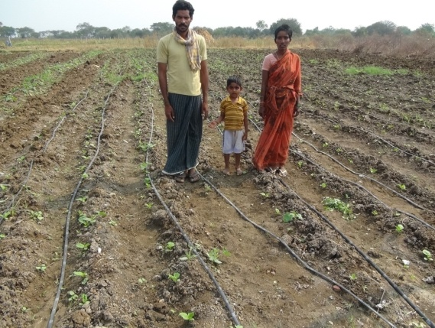
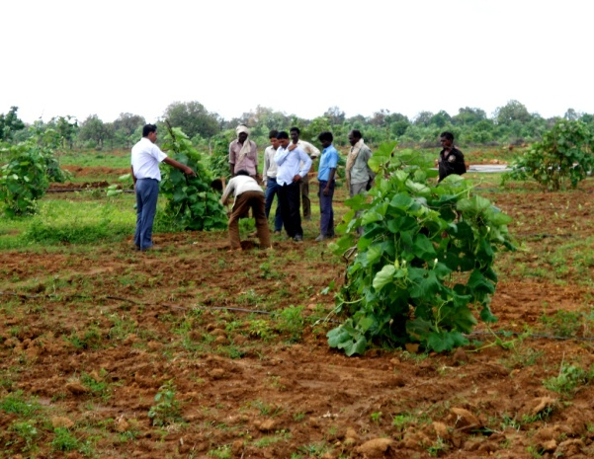

Convergence for development
Integrating
Safe Water Access +
Water Harvesting Initiatives +
Sustainable livelihood +
Improved ecological balance and biodiversity for model villages and area development program
Presented by –
Avani Mohan Singh,
Haritika – Jhansi

Slide 2
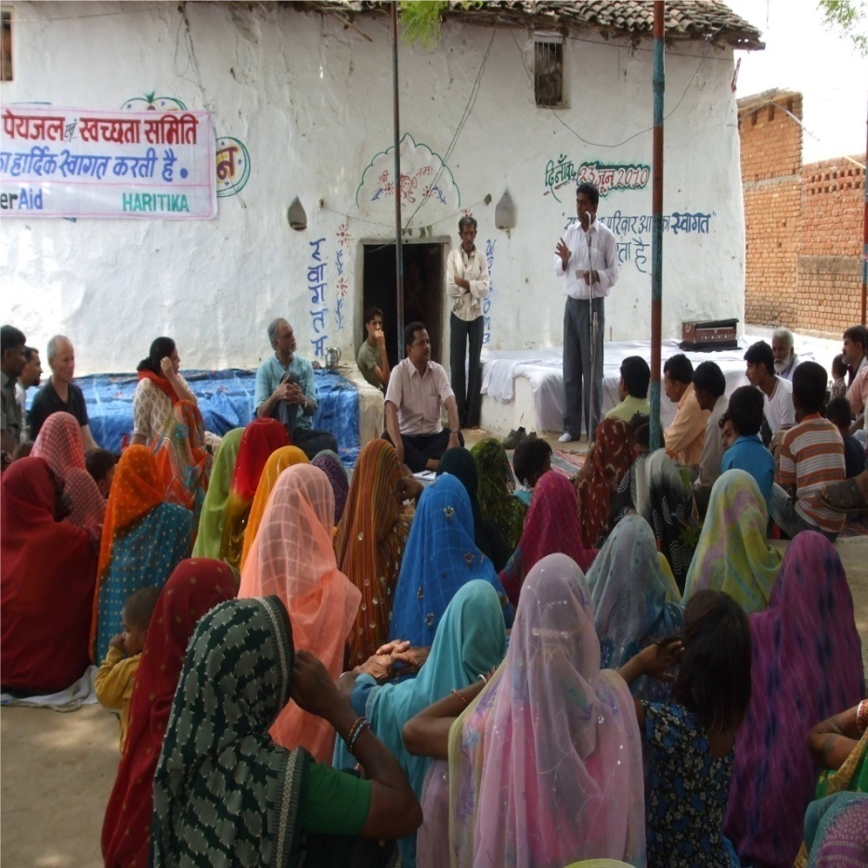
About Haritika
NGO working in Bundelkhand region of Madhya Pradesh since year 1994,
registered under Societies’ Registration Act, 1860.
Our Vision: A just, enlightened, healthy and democratic Bundelkhand free from hunger, poverty, environmental degradation and all forms of exploitation based on age, sex, religion and ethnicity.
Our Mission: The mission of Haritika is to work with people whose lives are dominated by extreme poverty, illiteracy, disease and other handicaps. With multifaceted developmental interventions Haritika aims to bring about positive change in the quality of life of the poor people of the Bundelkhand region of UP and MP.

Slide 3
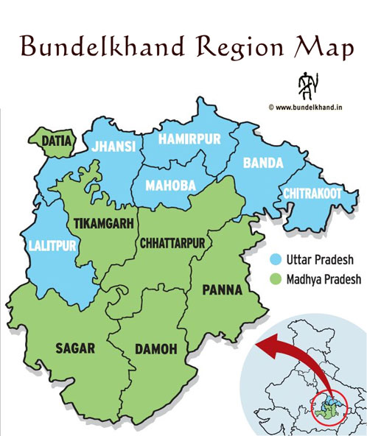

Project area
District Mahoba,Jhansi,Lalitpur (U.P) and Chattarpur ,Panna,Katni,Vidisha,Rajgarh,Khandwa(M.P.)
The major land use (68%) is under cultivation, out of which more than 57% is under Rain-fed / unirrigated agriculture. Approximately 25% is under the forests
Erratic rain fall recurring drought conditions and uncontrolled pumping of ground water from aquifers
Low water tables and increased levels of hard water.
Hard rock region with poor soil cover, uncultivable due to shortage of irrigation water. Undulating topography of the area resulting in soil erosion
Poverty rate
HDI Index
Gender Dynamics
Fragmented landholdings
Migration
Notes:
Bundelkhand is one of the most poorly endowed regions of MP, as far as natural resources are concerned.
and shortage of water for irrigation and domestic purposes.

Slide 6
Haritika intervention – Conceptual Framework
Integrated Water Resource Management Project
Livelihood project
Model village projects
Community based projects
Convergence of rural development themes
Convergence of the fundings
Anchor project
Additional projects
Additional projects
Additional projects
Additional projects

Slide 7
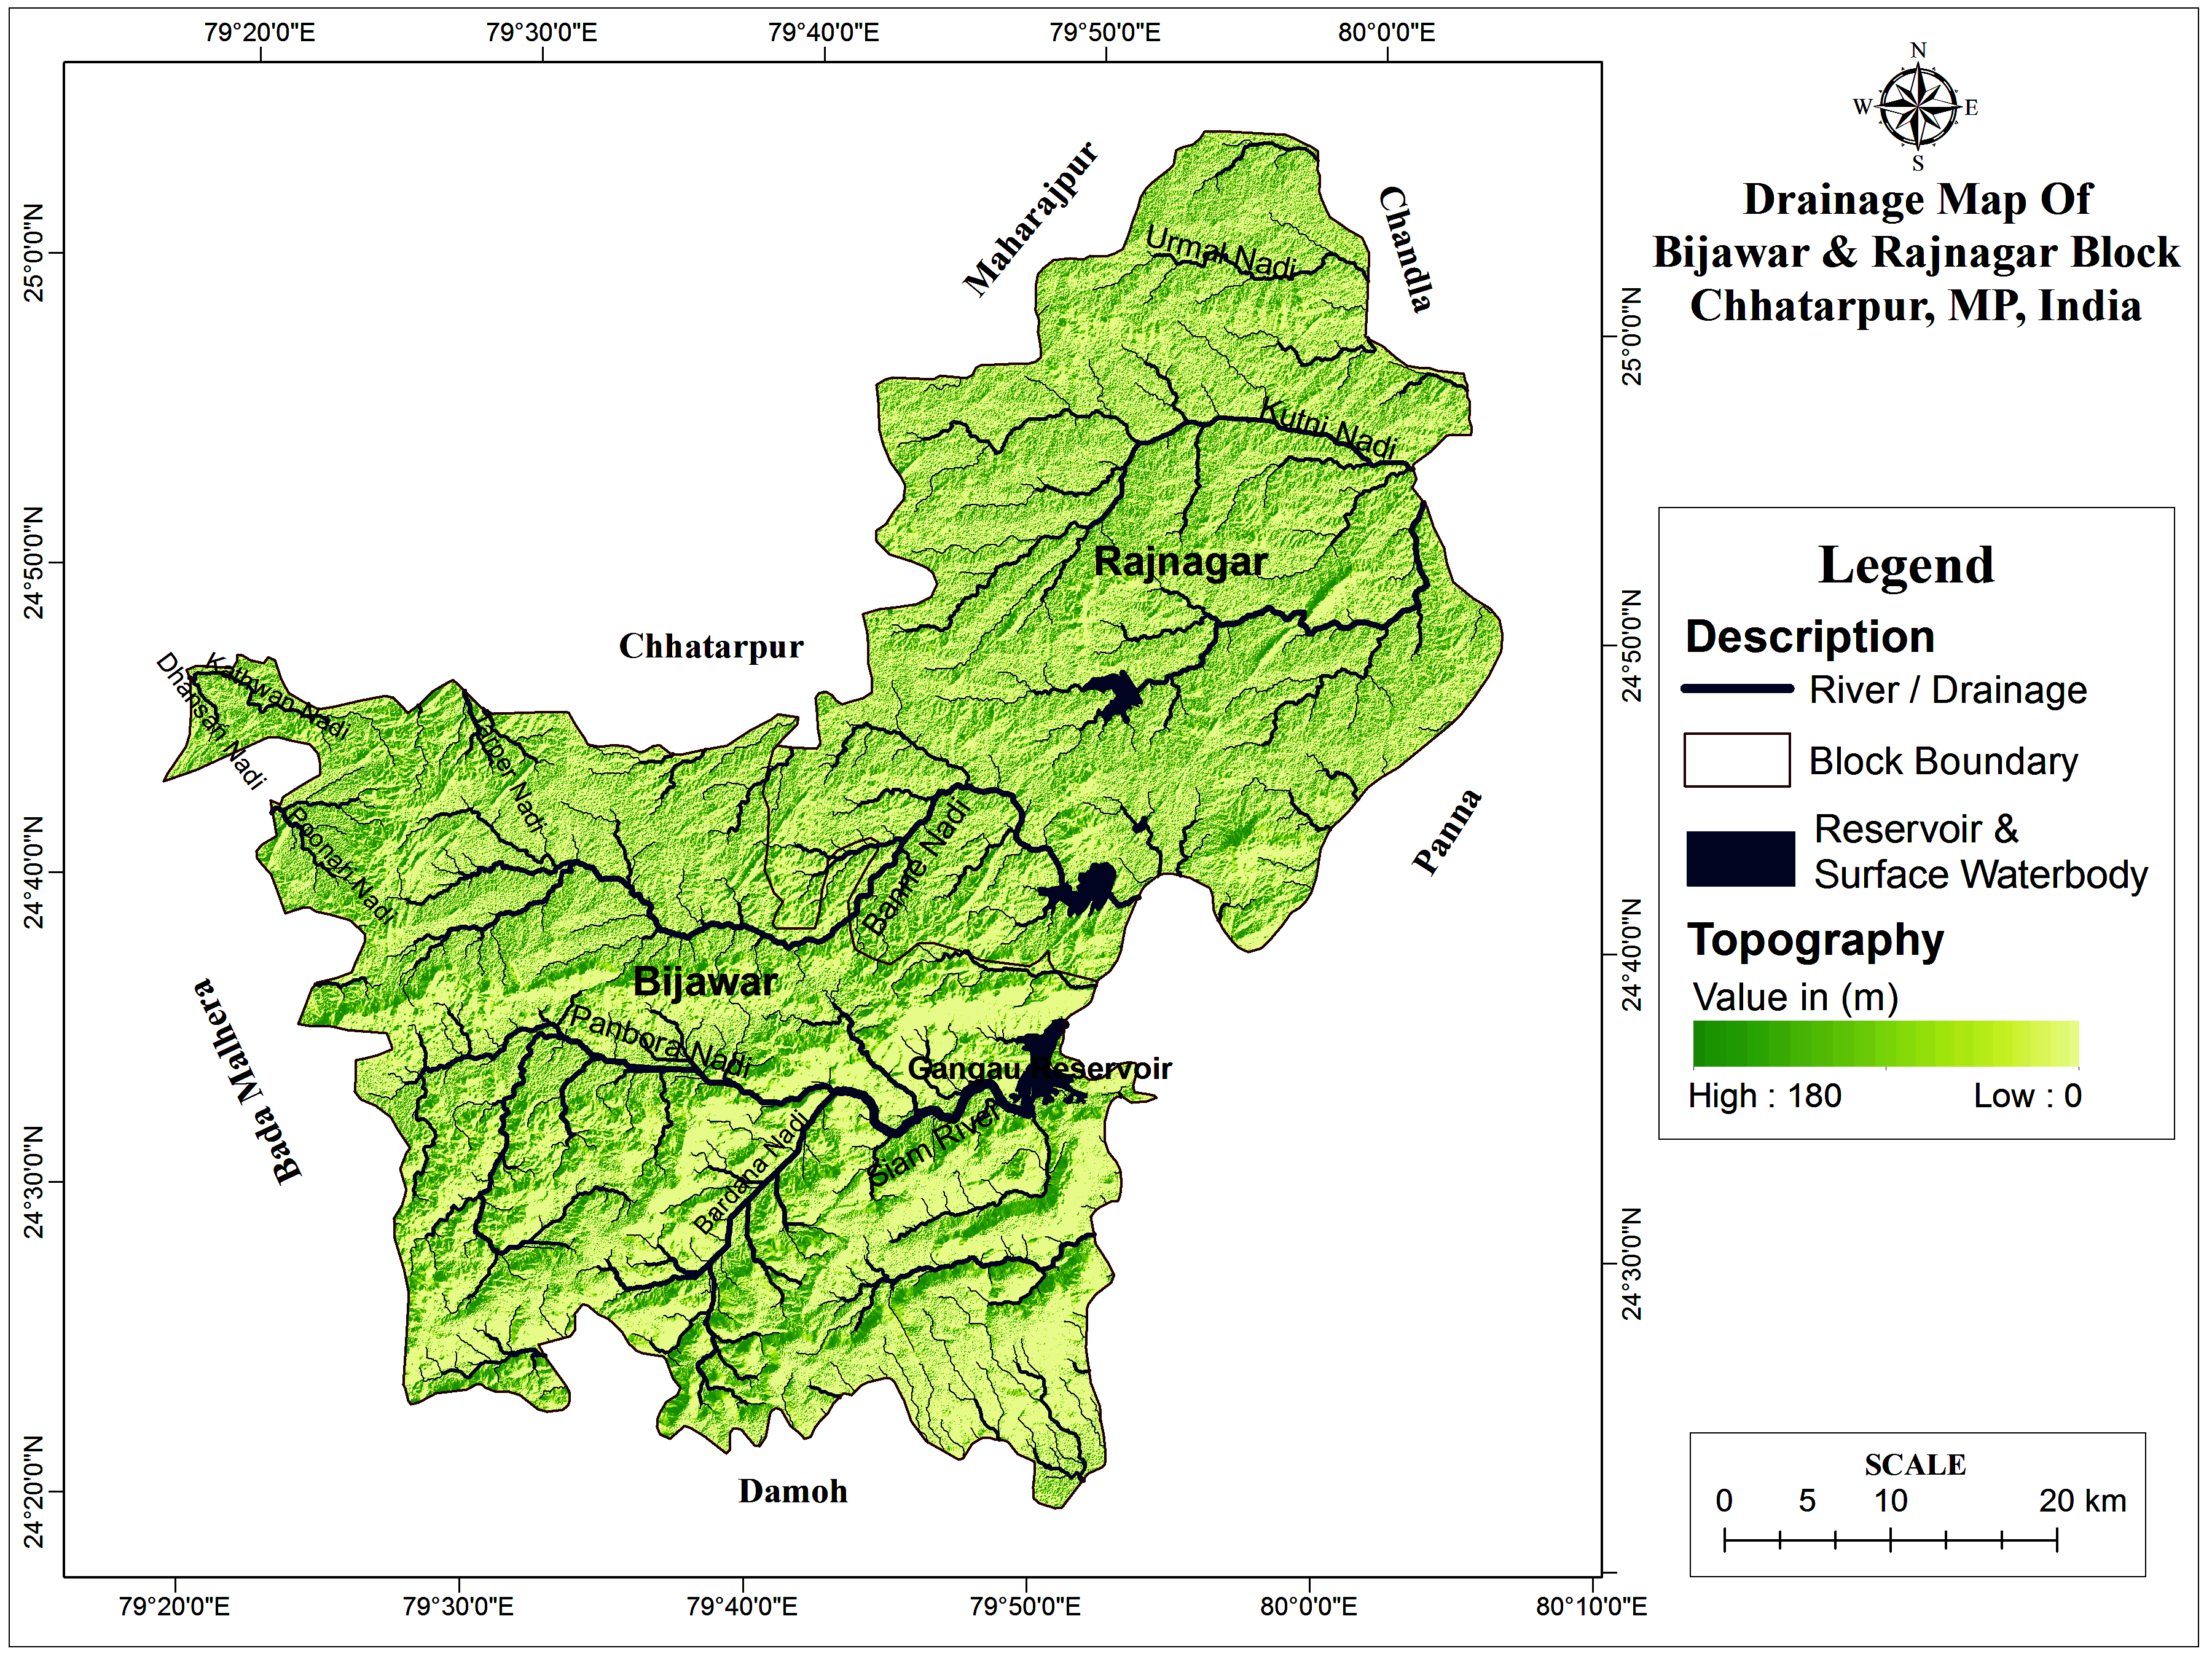
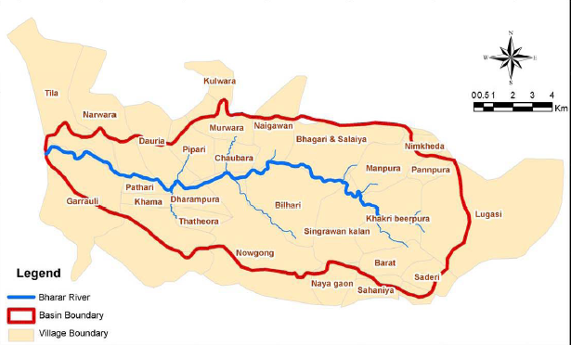
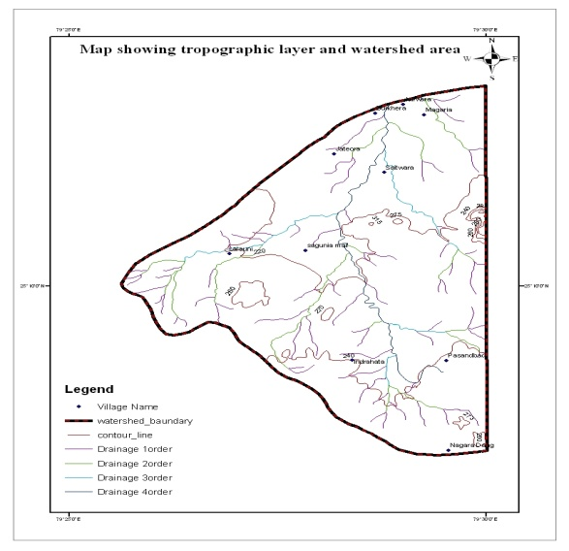
Area development approach
Bhadar River Basin in Chhattarpur
Karpia River Basin in Mahoba

Slide 8
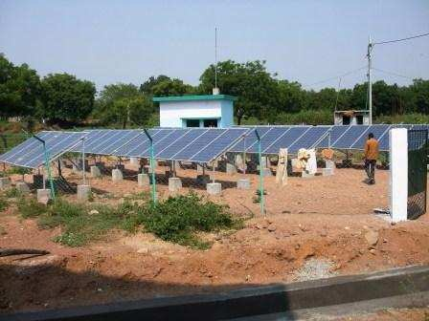
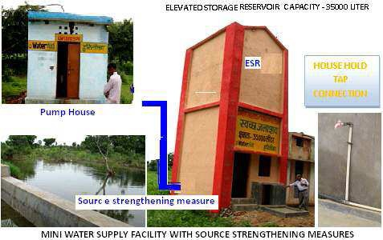
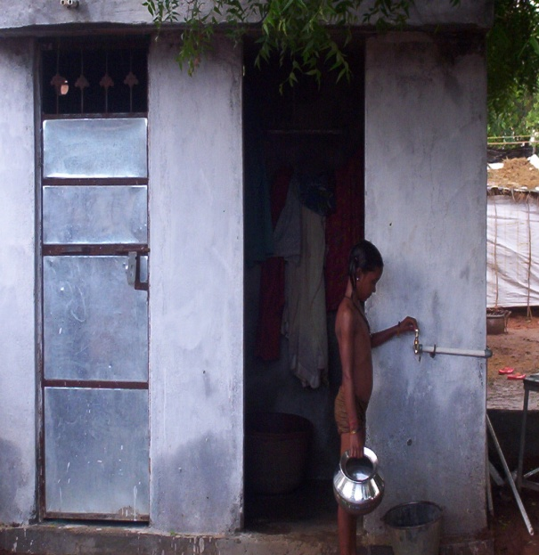
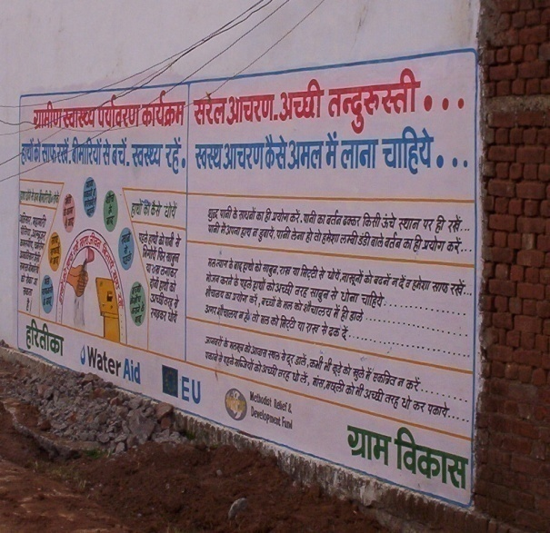
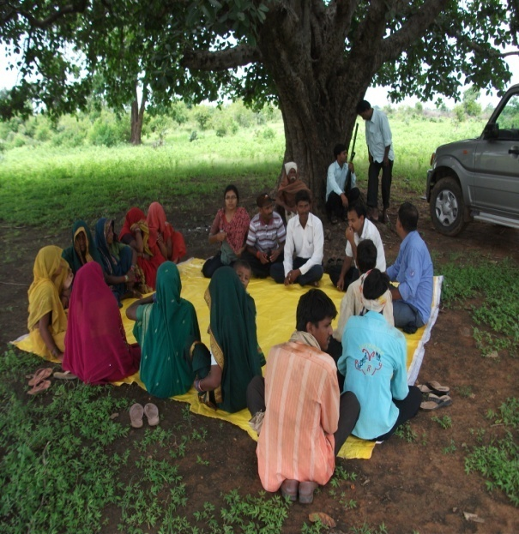
An Integrated Model Approach

Slide 9
Objectives and portfolio of activities
Objectives | Activities
Safe water Access | Bore-well Community dug-well | Sustainable community managed water supply systems Water quality lab
Water Harvesting Initiatives | Integrated water Resource Management package of practices for soil conservation, water harvesting, crop optimization and agro -forestry | Training and capacity building Agriculture extension Marketing of farm produce Kissan Nursary
Sustainable livelihoods | Fruit orchard development
Improved ecological balance and bio-diversity | Ecosystem management
Model Village and Area development Initiatives | Water, Wadi,Solar Energy, Cement Concrete Road, Saniation,T ree Plantation
Notes:
The coca cola foundation (Anandana) supported water based project was initiated in 2008. Major villages covered under the watershed are 15 villages of Jaitpur Block of Mahoba District, Uttar-Pradesh. Haritika, which was already working in the geographical area identified the villages based on the preliminary assessment and needs of the area for water based interventions.
It had been observed that there are quite a number of natural drainage lines in the area, which due to the undulating land profile, draining the major portion of runoff out of the watershed, whenever the rain occurs. As the water gets lesser opportunity to infiltrate into the local aquifers, it is affects the water resource status, negatively in low precipitation years. Good rainfall also does not do well for the same reasons. The undulating topography takes the water away and higher runoff velocities erode the soils and affect the nutrient availability in upper soils.
Along with the Community Based Environment Sanitation and Water Supply Project, Watershed based interventions like water harvesting structures and soil conservation structures/ practices have been implemented/ promoted to address the issue.
Thus the basic objective behind the entire project was:
To ensure drinking water security through 24*7 tapped drinking water supply in 15 villages of Jaitpur Block of Mahoba District, Uttar-Pradesh by augmenting ground water in a severely water stressed area and
to increase productivity of dry lands through a package of practices for soil conservation, water harvesting, crop optimization and agro forestry.

Slide 10
Convergence of activities

Slide 11

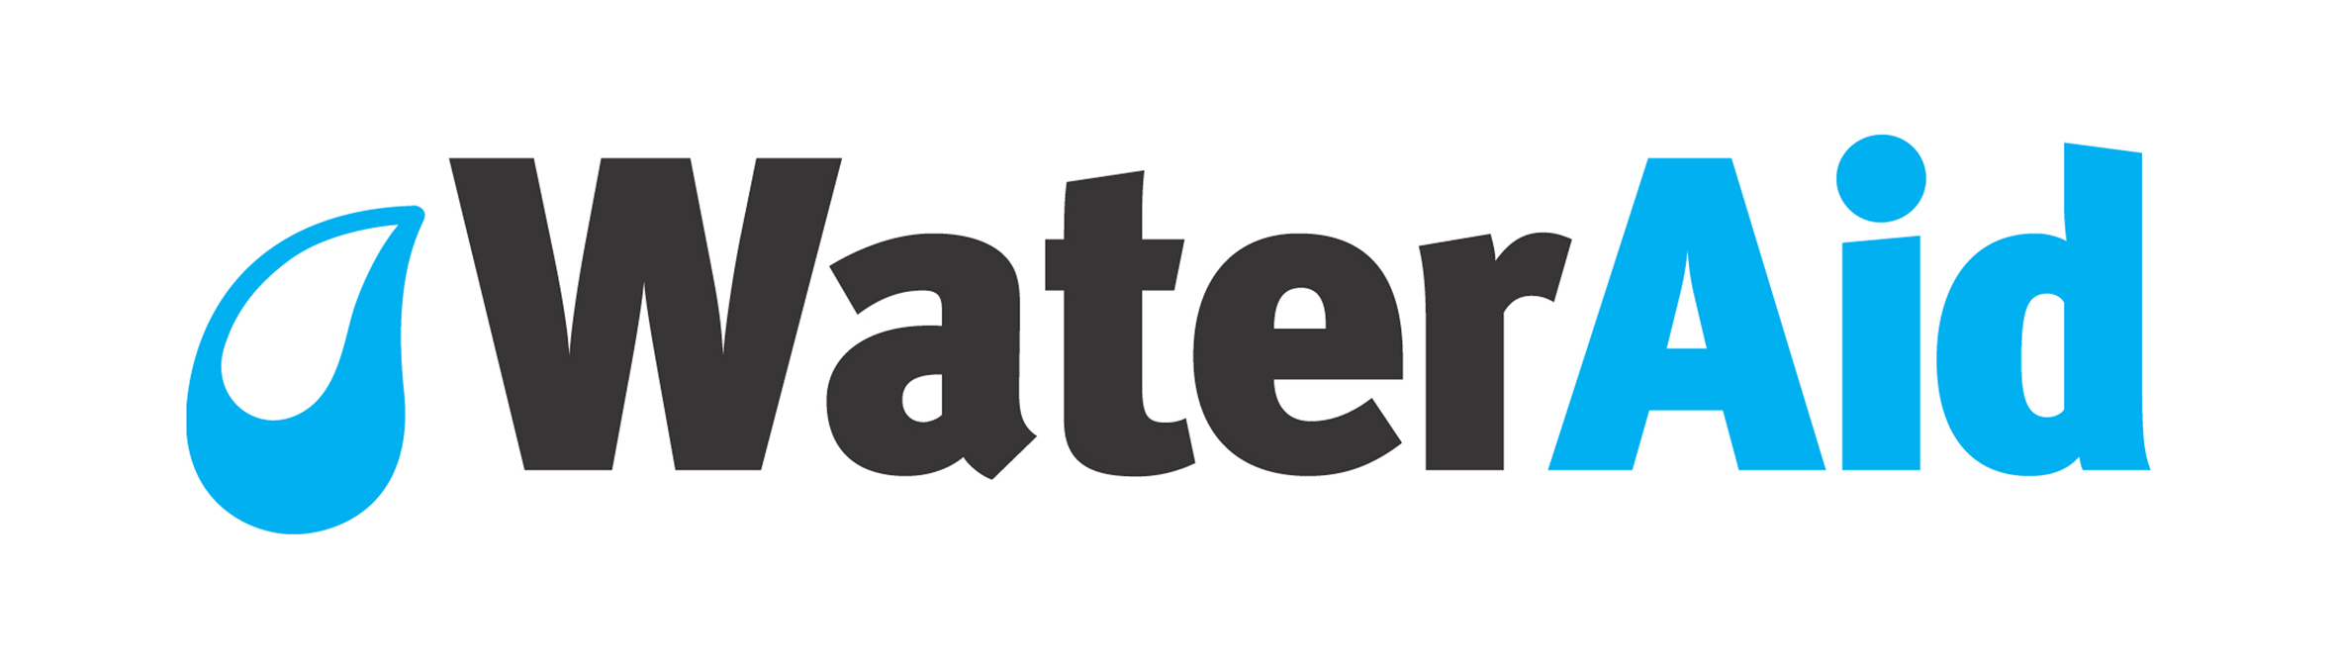
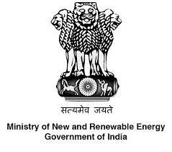

Convergence of projects
River Basin | Main Donors | Convergence with other organisation
Bhadar River Basin | Water Aid | Jila Panchayat Chhatarpur, The Nando peretti Foundation, One Day Wages, Water loo Foundation, District Poverty Initiative project, | MRDF, UK, Ryan's Well Foundation MNRE,Govt.of india, Norad
Karpia River Basin | The Coca Cola India Foundation | Just A Drop,UK, | The Project Solution,US, MNRE, NORAD
Bannaie River Basin | The Coca Cola India Foundation,NABARD | Just A Drop,UK,One Prosper International canada, | SDTT,Give India Foundation

Slide 13
Community engagement
Project Development
Project implementation
Operations and maintenance
Focus on inclusion as intervention is related to natural resources.
100% coverage of communities has created increased health benefits, and is more sustainable, than targeting specific groups.
However, in reality, those without access to water and sanitation will tend to be among the poorest.
Established Village water and sanitation committees
In this regard, communities, households and individuals were engaged and enabled to make an informed choice of:
Whether they want to participate in a project;
How services are to be allocated, managed, and maintained;
Service level options;
How contributions are to be made and managed
Conducted meetings and focussed group discussions in the villages
Identified problems and solutions related to drinking water and resources that can improve their quality of life.
On the basis of their responses we have planned to develop such type of project that can address their most of the problems related to water.

Slide 14
Environmental Impact
A significant impact on water availability and area under cultivation and preference of the crops.
Area under water reservoirs after the monsoon increased significantly (approximately to 468%) due to the construction and promotion of water harvesting structures in the watershed area.
Area under the Rabi crop has increased by 36% as compared to 2008, i.e. pre project period. Additionally area have spread away from the drainage line, which was limited to nearby drainage line before the project interventions and cultivation has increased in downstream side (lower reaches of the watershed
The area under kharif has, however decreased (by 38% approximately), in 2013 as compared to the base year.
Notes:
The simulation of groundwater flow through MODFLOW – 2005 has reflected that in the changed scenario, the average rainfall of more than 800 mm could be enough to keep the ground water by January in most of the open wells (73 % wells) in the watershed area. In case of the average annual rainfall reduced to less than 800 mm, still 20% of open wells are expected to remain operational till December, which otherwise lose their yield by the end of October. As the simulations are always have limited number of variables and parameters as compared to practical situations, actual results may vary depending on the spatial and temporal distribution of rainfall, changed cropping pattern, which will itself be impacted by the water resource availability and other factors which are not under control.

Slide 15
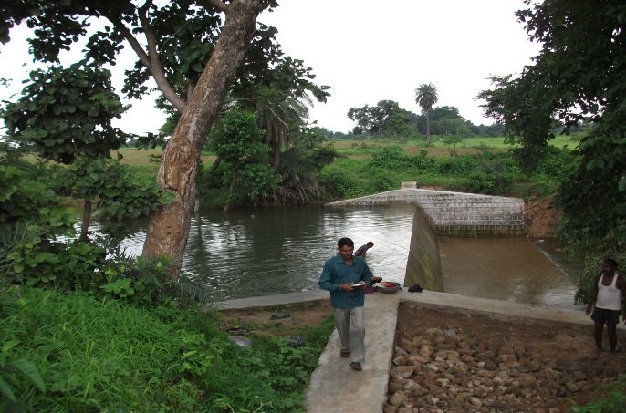
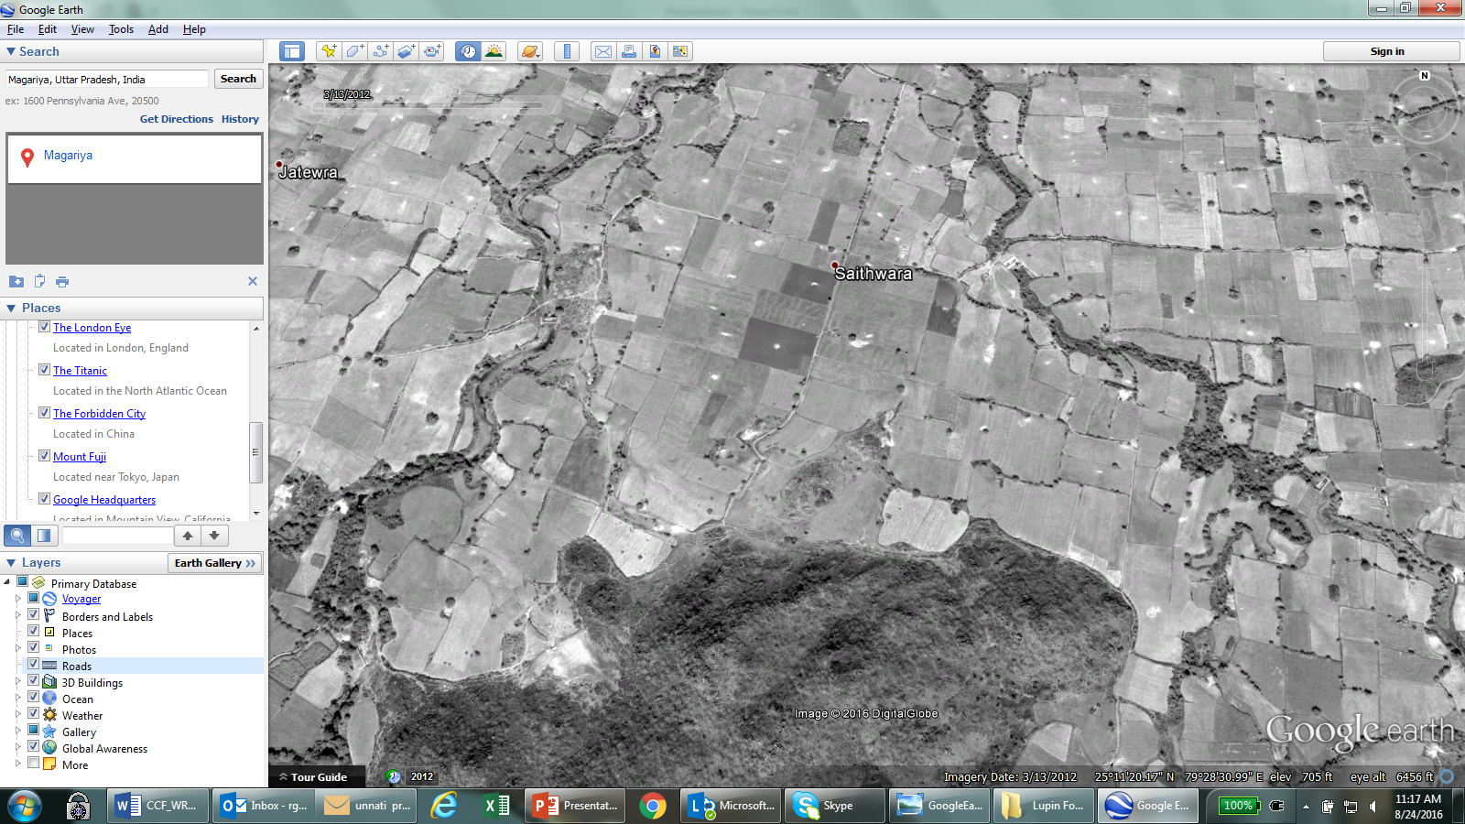
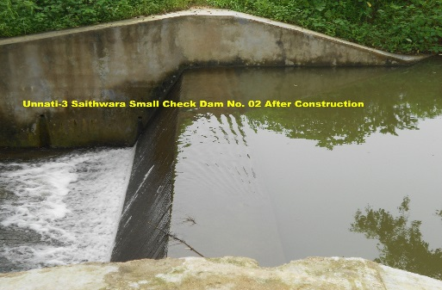
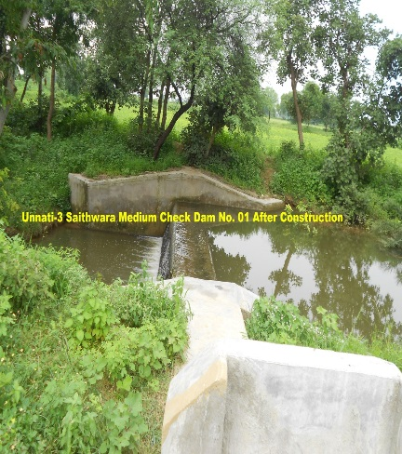
completed check dams, marked on google earth….March 2012
Saithwara CD-II
Saithwara CD - I
Saithwara CD-III

Slide 16
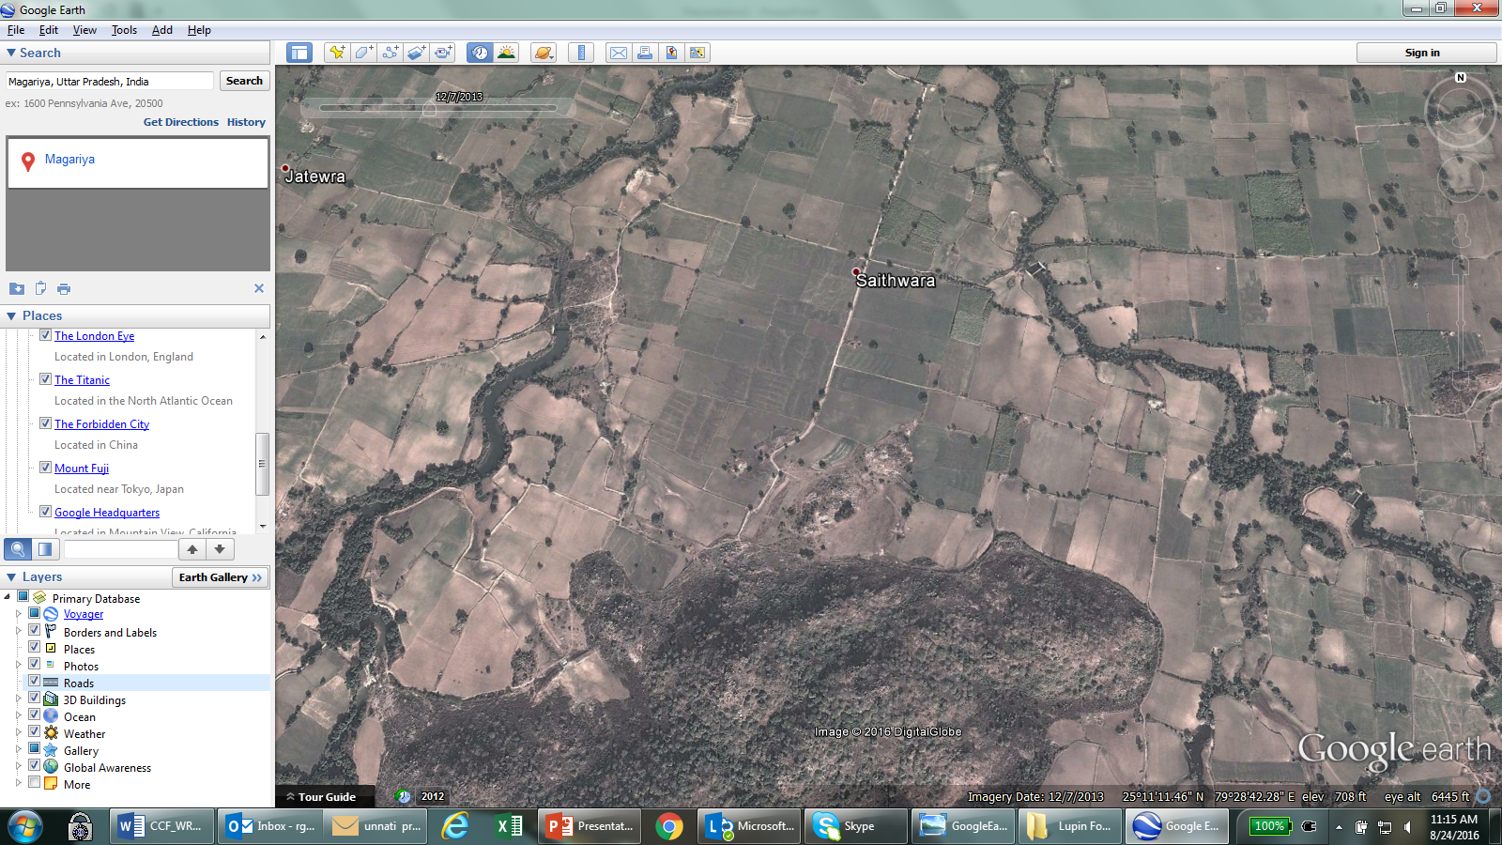
A late monsoon & deficit rains in 2013….December 2013

Slide 17
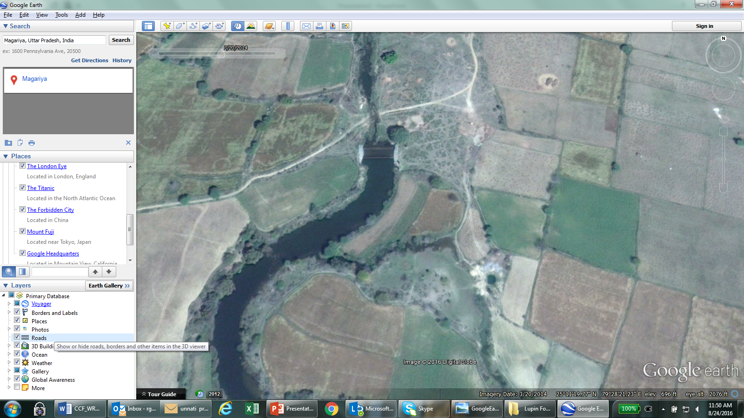
A closer look at our check dam with water….

Slide 18
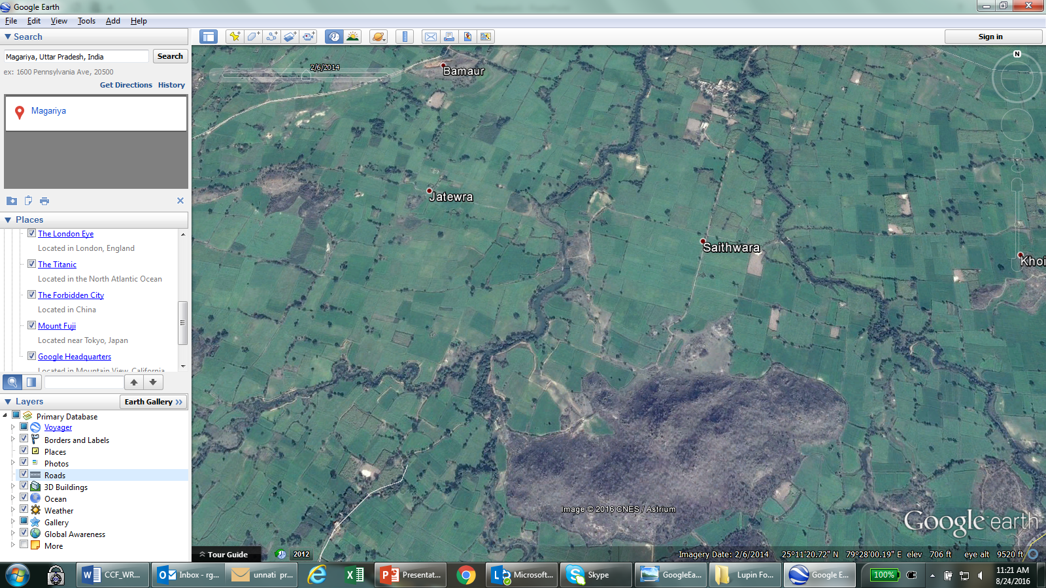
winter crop of wheat near our project sites … February 2014

Slide 19
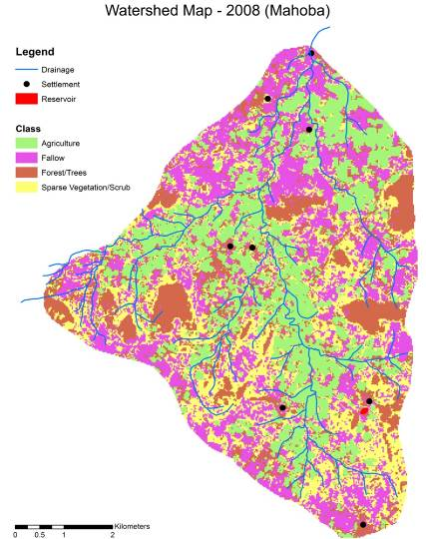
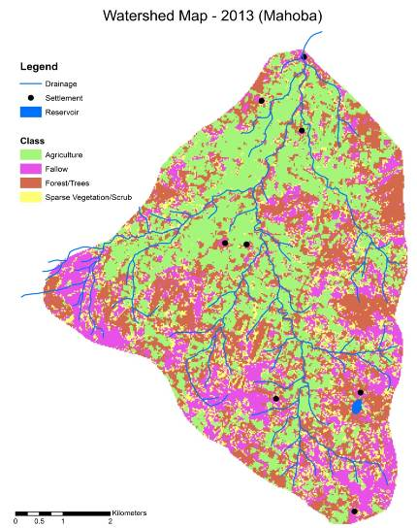
Environmental Impact
Pre Project Phase (impact of monsoon) – 2008 Vs 2013

Slide 20
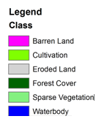
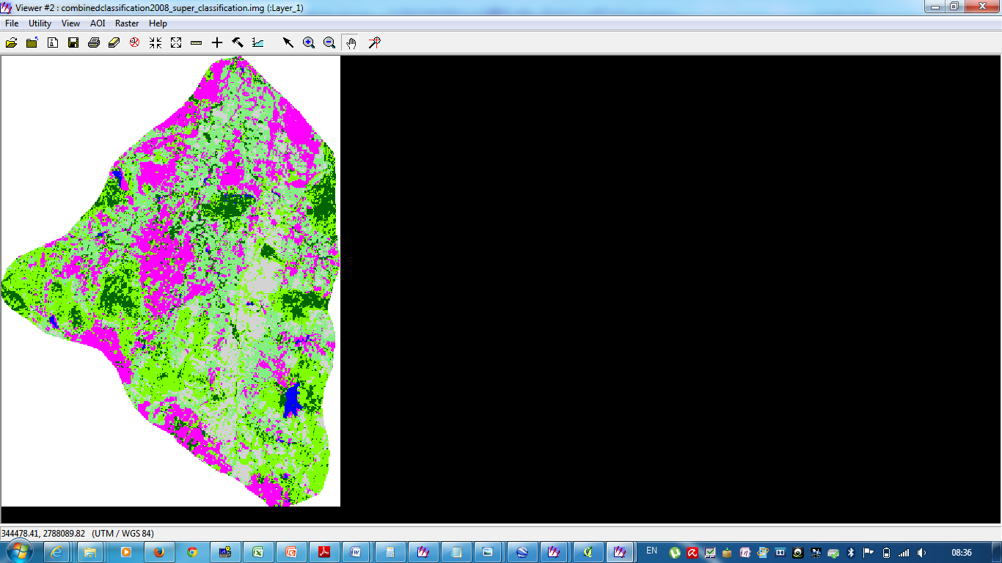
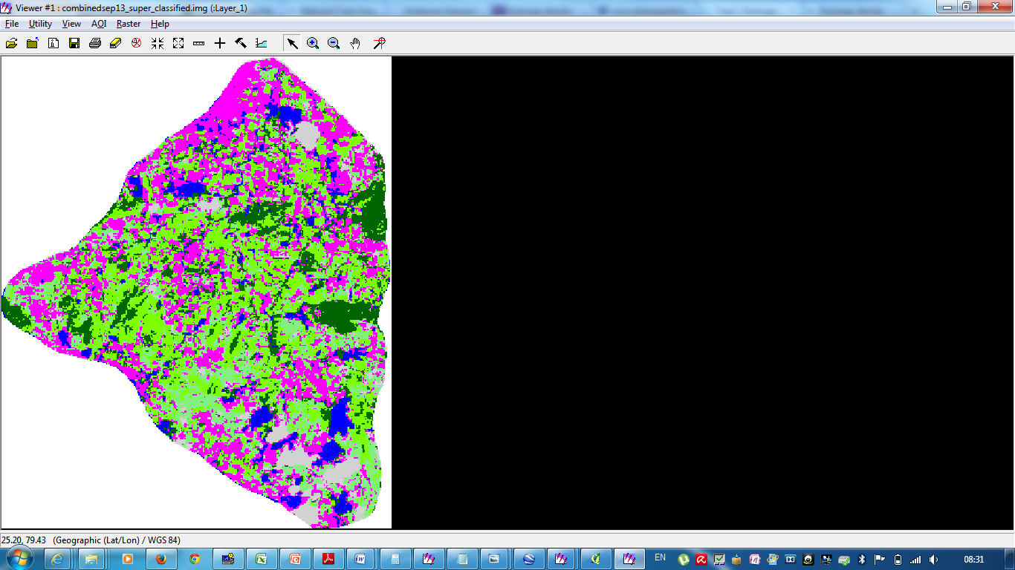
Environmental Impact
Post Project Phase (impact of monsoon) – 2008 Vs 2013

Slide 21
Socio-economic impact
Outreach
  45 GPs, 42,000 people are getting assured water supply to meet drinking and domestic water requirement by storing more than 1 billion liters of water
  Irrigation facility to approx. 20,000 farmers and approx. 15000 acre land
  A fully equipped water quality and soil testing laboratory in its field office.
Health
  Villagers have access to chlorinated safe water the medical expenses being reduced as health improves. This leads to increased “disposable” income.
  Reduction in genito-urinary infections, reduced incidence of back pain caused by carrying water over long distances
  A reduction in the incidence of water and sanitation related disease that has reduced the infant mortality as infants are particularly susceptible to water-related diseases.
  Reduction in malnutrition rates. Diarrheal episodes affect the ability to absorb nutrition from food.
Sustainability
  Through concerted software support to the local institution and hand holding support, created infrastructure of rural water supply can be sustained over a long period of time.

Slide 22
Socio-economic impact (Contd)
Gender aspects
  Reduced mental stress caused by anxiety over distribution of limited fresh water
  Increased educational attendance of girl children, in project villages.
  Females’ involvement in successful developmental projects has often led to their being accepted as key actors within village development. These can range from increased involvement in domestic financial decision-making to increased involvement in political decisions such as vote casting.
Improved awareness
  Hygiene promotion activities have been organized like-: Hand washing Campaigns, Hygiene related trainings of children, school teachers, aanganwadi workers, VWSC & SHG members, Hygiene promotional songs & events, skits etc
Social equality
  Women and lower caster representation and ability to voice their concerns and participation in decision making
Improve farm productivity
  Overall increase in productivity and subsequently income from farming, 40% to 50% in every beneficiary family.
  Farmers have easier access to financial resources through close linkages with banks, insurance and governmental institutions.
  A well-established value chain for post-harvest handling and processing, have been established in project area.
  Knowledge network among farmers for sharing their experience and learning new technology have been establishes

Slide 23
Institutional sustainability plan
PRI Representatives
Women and lower caste representatives
Haritika Representative
Village Water and Sanitation Committee
O & M Fund Management
Shared ownership
Grievance Redressal
  At the time of initiation of project, a corpus fund has been developed for the VWSC.
  The bank signatories for the committee are one representative each from the women group and Haritika.
  Strict vigil over the proper functioning of the system, look into grievances of people.
  One year in every village building capacities and constructing the water and sanitation system.
  Facilitation of the VWSC meetings closely for the first year.
  Gradual withdrawal to ensure institutional mechanism are functioning effectively.
  Formal Withdrawal meeting
Notes:
The Village Level Committees would continue to function in spite of completion of the project.
The users and caretakers will be assisted to participate in all aspects of the project cycle to ensure that there is a sense of commitment and ownership and they will be equipped with the knowledge and capacity to make their project sustainable.
Effective community-based maintenance systems will be put in place, and will be linked to district networks and to their local administrations.
Facilitate availability of local skilled labour, which can charge affordable rates for maintenance and repair work
Maintenance would be done through community contributions from beneficiaries.

Slide 24


Financial sustainability of the programme
One-time Household contribution –
Rs. 1000
Monthly fixed user charges
10% of total watershed cost by farmers who have land nearby the structure
Operations & Maintenance Corpus Fund

Slide 25
Community empowerment and awareness
Fiduciary responsibilities
Awareness creation
Theme based training programs
Village Water and Sanitation Committee
Water supply scheme Quality Control, supervision,
Financial Management,
Water disinfection,
Operation & Maintenance,
System & Source sustainability
Water Security
Notes:
have been provided to the members of VWSC, SHG etc. have been provided. Initially in these training programs women have not participated but they have also started to show their interest in training programs by assuring their participation.
At initial level the participants were not even able to give their introduction in front of whole participants group but now they express their own views on water related issues and also give their presentations in front of all the participants. Although they are not properly aware of all of their rights, problems & associated solutions but it is assumed that while working with them for 6-7 months extra, we can be able to make them aware of their rights & responsibilities
The reason behind formation of these kinds of groups is that no outsider can remain in these villages forever to take care of their water problems they themselves have to take the whole responsibility of their own assets.

Slide 26
Challenges and Haritika approach
Challenges | Solution approach
Staggered onboarding of village people in the project | Designing of the pipeline
Land for Water Conservation structures | Permission letter from all the farmers
Financing of the projects | Convergence, local financing of O&M costs

Slide 27
Innovation
Convergence of projects and funding pattern
Integration with renewable energy projects for sustainability and reduced O & M.
Kissan nursery and package of cultivation
Process innovations
  Staggered onboarding of the community

Slide 28
